Slide 1
Short presentation title up to 2 lines
Subheading up to two lines only or delete
Date

Slide 2
Short presentation title up to 2 lines
Subheading up to two lines only or delete
Date

Slide 3
Short presentation title up to 2 lines
Subheading up to two lines only or delete
Date

Slide 4
Short presentation title up to 2 lines
Subheading up to two lines only or delete
Date

Slide 5
Agenda – short headings have more impact
Agenda point one goes here in Verdana 14pt in black | 00
Agenda point two goes here | 00
Press the Tab key after agenda topic | 00
Manually update the respective page number | 00
This layout has been set up as a table | 00
Press TAB key at end of table to insert a new line | 00

Slide 6
Five levels of text styles in this template
Level one text, subheading Verdana 18pt
  Second level, body copy Verdana 18pt
    Third level, bullet copy Verdana 18pt
      Fourth level, dash copy Verdana 18pt
        Fifth level, dot copy Verdana 18pt
  The hierarchy of text styles enables the most important information to stand out (and the supporting details less prominent)
  There is a quick and easy way to swap between these five levels without having to fuss about adding / removing bullets – see over for details …

Slide 7
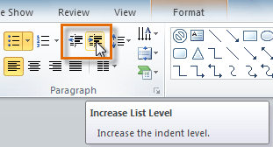
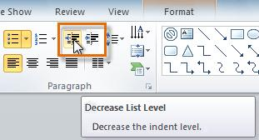
How to swap between different text styles
    List levels enable you to quickly switch between text style levels – e.g. subheading style, body text and bullets.
    This is one of PPT’s most useful but least understood features
    The default list level is the level one orange subheading style. You need to press the “Decrease List Level” button once or twice to change to body copy (one click) or bulleted text (two clicks)

Slide 8
Title and content slide
Level one text, subheading Verdana 18pt
  Second level, body copy Verdana 18pt
    Third level, bullet copy Verdana 18pt
      Fourth level, dash copy Verdana 18pt
        Fifth level, dot copy Verdana 18pt
    If you delete all the content in a placeholder, the empty placeholder will display six icons in the centre. Click on one of the icons to add another type of content such as a table, image or chart

Slide 9
Title and two content layout
Level one text
  Level two text
    Level three text
      Level four text
        Level five text
    Click “Increase List Level” or “Decrease List Level” in the Home> Paragraph menu to automatically switch between text level styles
Subheading Verdana bold 18pt
  Body copy Verdana 18pt
    Bullet copy Verdana 18pt
      Dash copy Verdana 18pt
        Dot copy Verdana 18pt
To add other content:
    Delete all the sample text level copy and the placeholder will reveal icons to add a table, chart, etc.

Slide 10
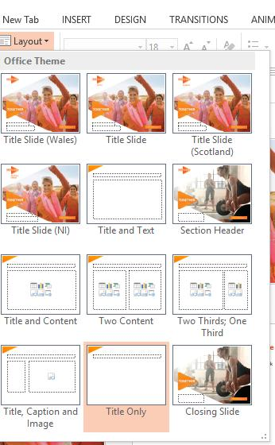
Slide layouts
    Slide layouts contain formatting, positioning, and placeholders for all of the content that appears on a slide as well as the theme.
      There are 12 (TBC) unique slide layouts in this PowerPoint template
      Select the slide that you want to apply a layout to.
      Go to Home> Slides> Layout and then select one of the 12 custom layouts to change the layout of a slide

Slide 11
Title and table slide
Heading 1 in bold | Heading 2 in bold | Heading 3 in bold | Heading 4 in bold
Table text goes here Verdana 14pt | Table text goes here | Table text goes here | Table text goes here
Table text goes here | Table text goes here Verdana 14pt | Table text goes here | Table text goes here
Table text goes here | Table text goes here | Table text goes here Verdana 14pt | Table text goes here
Table text goes here | Table text goes here | Table text goes here | Table text goes here Verdana 14pt
Table text goes here Verdana 14pt | Table text goes here | Table text goes here | Table text goes here
Table text goes here | Table text goes here Verdana 14pt | Table text goes here | Table text goes here

Slide 12
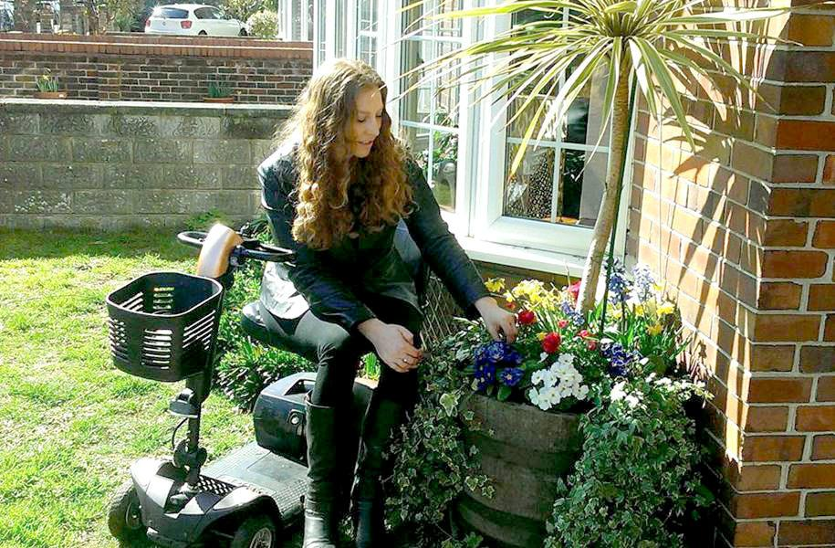
Title, caption and image slide
Soft return
    A very useful tool to move text onto the next line without starting a new paragraph. Press SHIFT+RETURN keys to move some text if it is too close to some graphics

Slide 13
Title and quote slide
 | “This is a quote slide and the text goes here. Use Verdana 18pt aubergine text with the justify paragraph style. The quote text is set up in a table. Keep the first and last columns empty and only type into the central column.”
 | Speaker name goes here (or delete this line)

Slide 14
Icons
(change Shape Fill colour of graphic if required)

Slide 15
Colour scheme and sequence
227
82
5
110
43
98
79
117
139
0
156
166
1.
MS Orange
2.
MS Aubergine
3.
Slate Blue
4.
Teal
247
161
122
166
118
165
136
160
175
93
196
207
5.
MS Orange tint
6.
MS Aubergine
tint
7.
Slate Blue
tint
8.
Teal
tint

Slide 16
Divider slide 1

Slide 17
Divider slide 2

Slide 18
Divider slide 3

Slide 19
Sample charts
    This template features a sample line, column, bar and pie chart over the next few slides
    These charts are included so you can see how the charts should look in the MS Society style
    The four sample charts feature up to 8 data series and these are displayed using a specific sequence of MS Society brand colours:
1.
2.
3.
4.
227
82
5
110
43
98
79
117
139
0
156
166
MS Orange
MS Aubergine
Slate blue
Teal
5.
6.
7.
8.
247
161
122
166
118
165
136
160
175
93
196
207
Orange tint
Aubergine tint
Slate blue tint
Teal tint

Slide 20
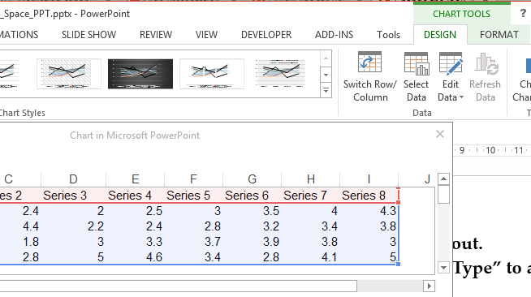
Modifying chart data
    Right-click on a chart and select “Edit Data” from the drop-down menu to edit the chart directly in PowerPoint
    The green “Chart Tools” tab appears at the top of the PowerPoint window. If you do not see the “Chart Tools” tab or the Design tab under it, make sure that the chart is selected
    The data sheet will appear and edits should be made here to make changes to the chart.

Slide 21
Line chart and pie chart

Slide 22
Column chart and bar chart

Slide 23
How to create a new PPT presentation
    Go to New> Custom Office templates and access the MS Society PPT template
    File>Save As>[PresentationName].pptx
    Then work directly in this new PPT file to create your presentation (delete any unwanted sample slides)
    N.B. Check with your IT team that the MS Society PPT template is available in your templates folder
New slides
    Go to Home> New Slide (or Ctrl + M) and choose a new slide layout to insert

Slide 24
How to update old presentations
    Copy and paste your old slides into a new presentation based on the new MS Society template
    When you paste your slides into the new file you will see a drop-down paste icon appear in the bottom right
    Please click “Use Destination Theme”
    (this will ensure the template's theme
    is applied to your old slides)
    You will need to manually tidy up some of your old slides, including applying the correct slide layout
Reset button
    To tidy up the slide elements, go to Home> Slides> Reset to reset the positioning and formatting of the slide layout to their default settings

Slide 25
Guides
Drawing guides are horizontal and vertical lines that help you visually align and position pictures, shapes and other objects in an organised way across a slide deck
    They're not visible during a slide show and do not print
    You can display or hide drawing guides (press Alt+F9 to turn guides on and off)
    When the guides are turned on, by default, PowerPoint displays one horizontal and one vertical guide that intersect at the centre of the slide
    To add additional guides, hold CTRL, click an existing guide, and then drag it to a new location; to delete a guide, click and drag it off the slide
    Guides should be set up to align with this slide to help ensure that all content fits inside the main placeholder.

Slide 26

Thank you

Slide 27

Thank you

Slide 28

Thank you

Slide 29

Thank you

