Slide 1

MS Society Stop MS Appeal
Notes:
These slides are for you to use when talking to stakeholders about the Stop MS Appeal.
We’ve made the slides as comprehensive as possible so there is a lot of information. Please pick and choose what works for your audience and remove, add, chop and change the slides to suit what you need.
For more information about the Stop MS Appeal, please visit the Stop MS website or get in touch with one of the team.
For some information about the public launch of the Stop MS Appeal, please see the ‘brandbook’ on VolWeb.
For more information about Stop MS research, please see the ‘research story’ on VolWeb.

Slide 2
Stop MS – What is it?
Notes:
For more information about the Stop MS research, please see the our ‘research story’ on VolWeb.

Slide 3
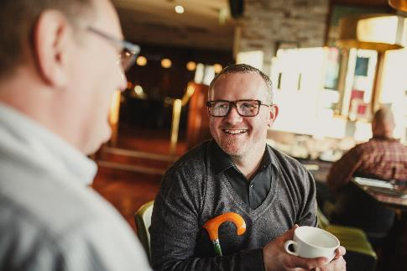

What is MS?
    Over 100,000 of us in the UK have MS
    It’s unpredictable, and different for everyone
    It’s often painful, exhausting and can cause problems with how we walk, move, see, think and feel
    But it doesn’t have to be this way
    We’re driving research into more – and better – treatments. For everyone
    Together, we are strong enough to stop MS…
Notes:
What is MS?

Slide 4
Notes:
You can find a video explaining what MS is here. You can also embed it into the slides if that works better for you.
https://www.youtube.com/watch?v=RaSD7FnsSDs

Slide 5
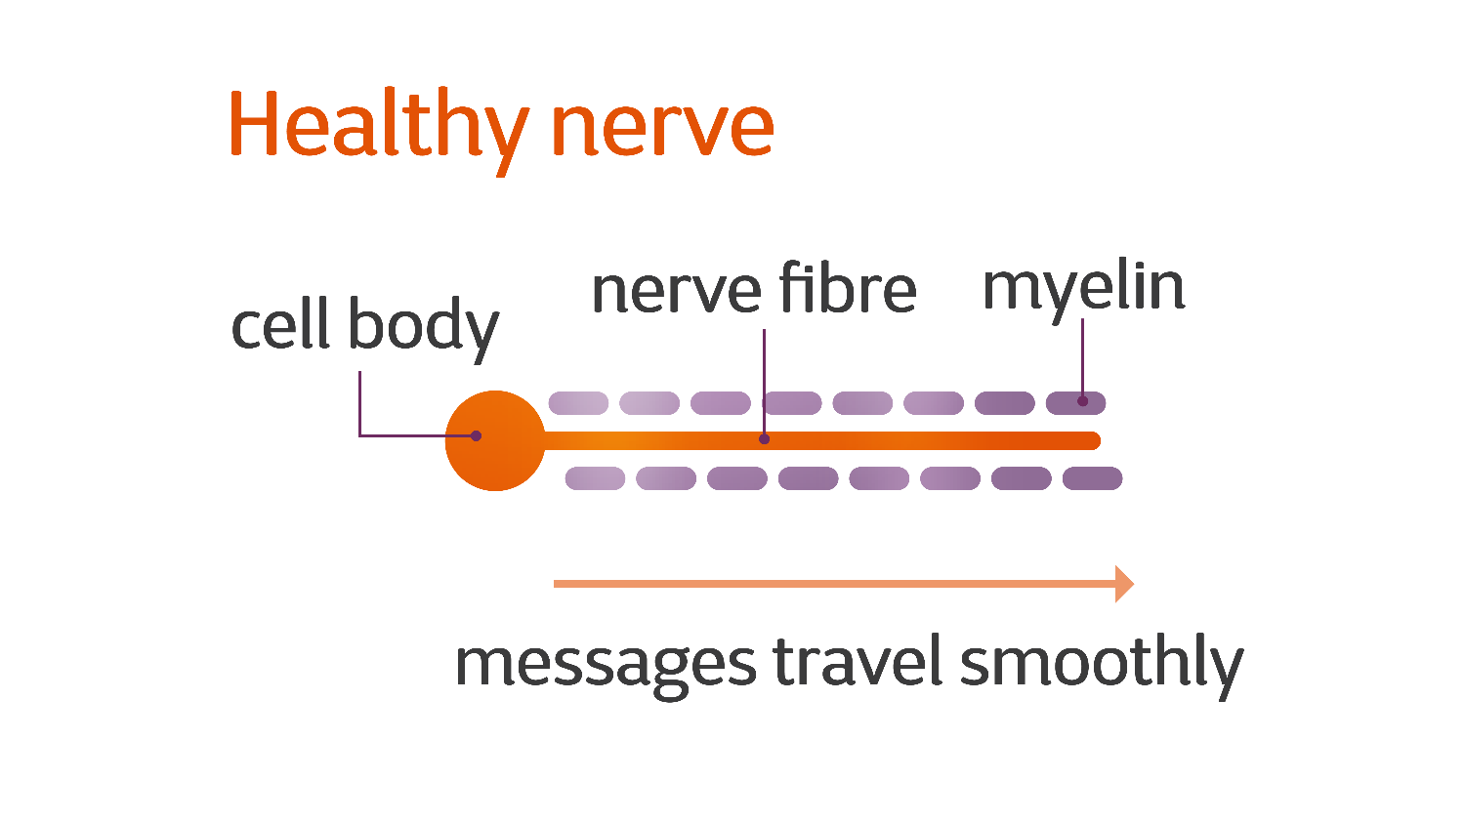
What is MS?
Notes:
What is MS?

Slide 6
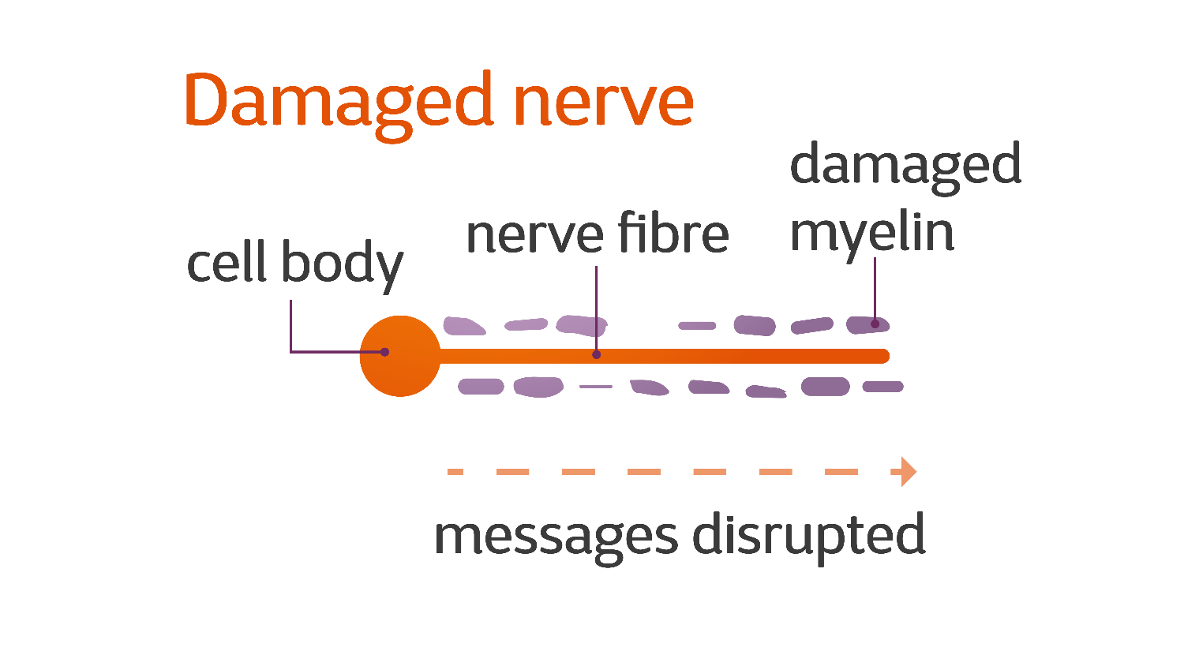
Notes:
What is MS?

Slide 7
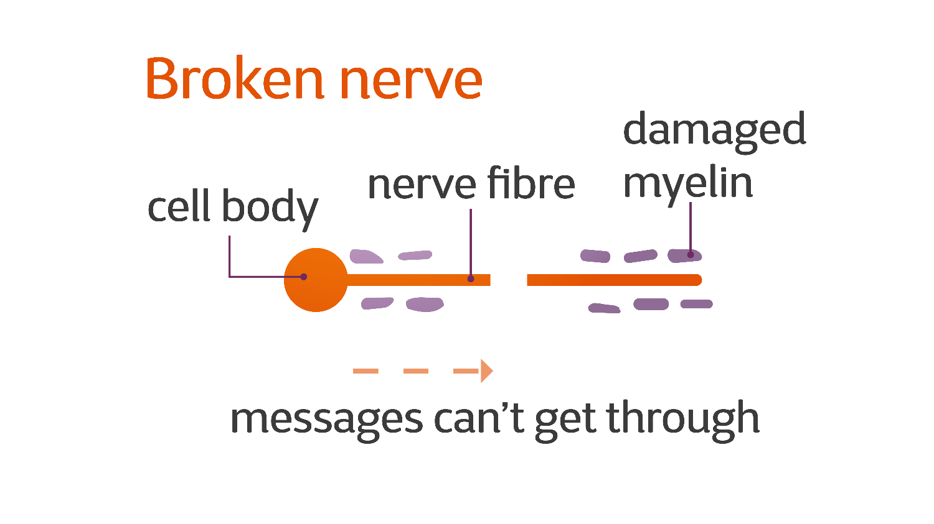
Notes:
What is MS?

Slide 8
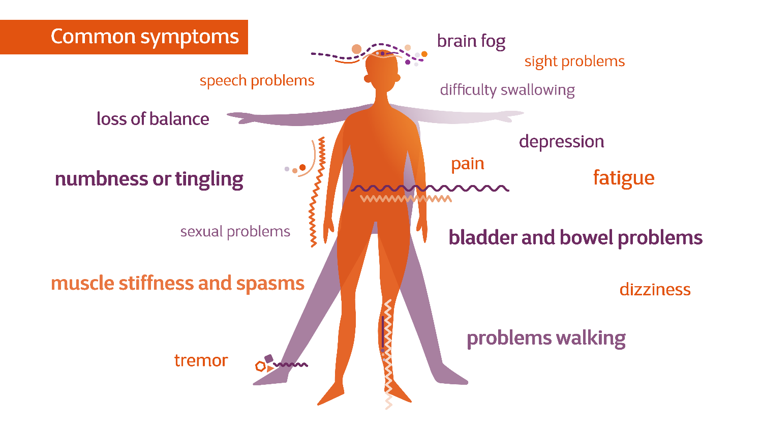
Notes:
What is MS?

Slide 9
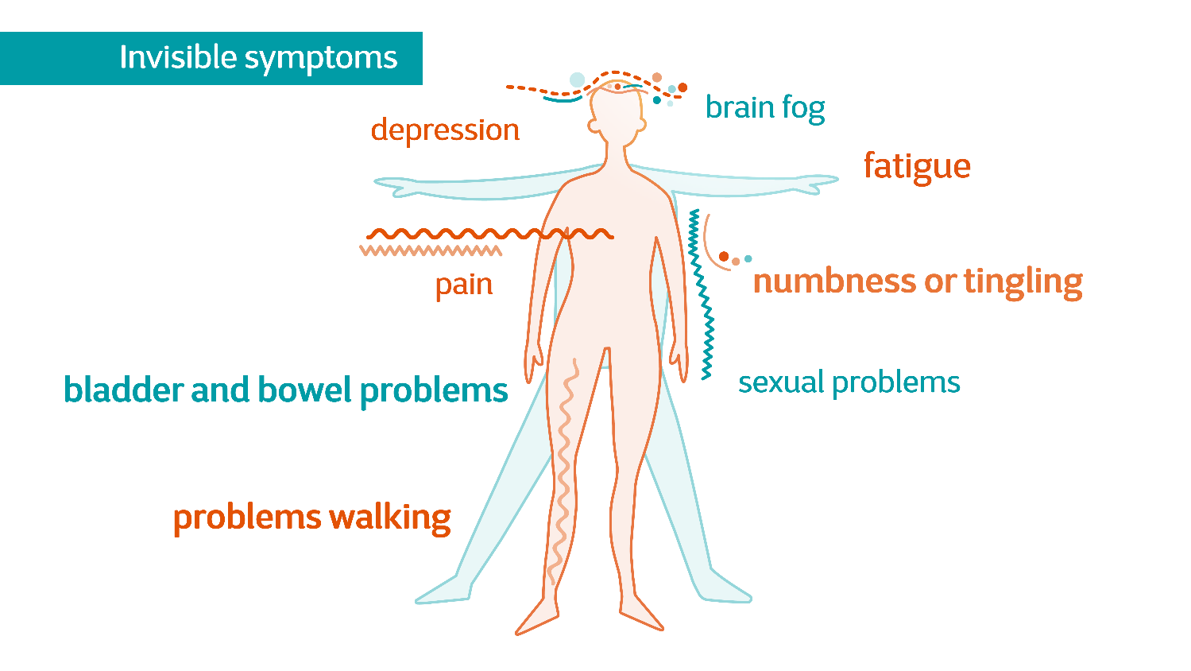
Notes:
What is MS?

Slide 10
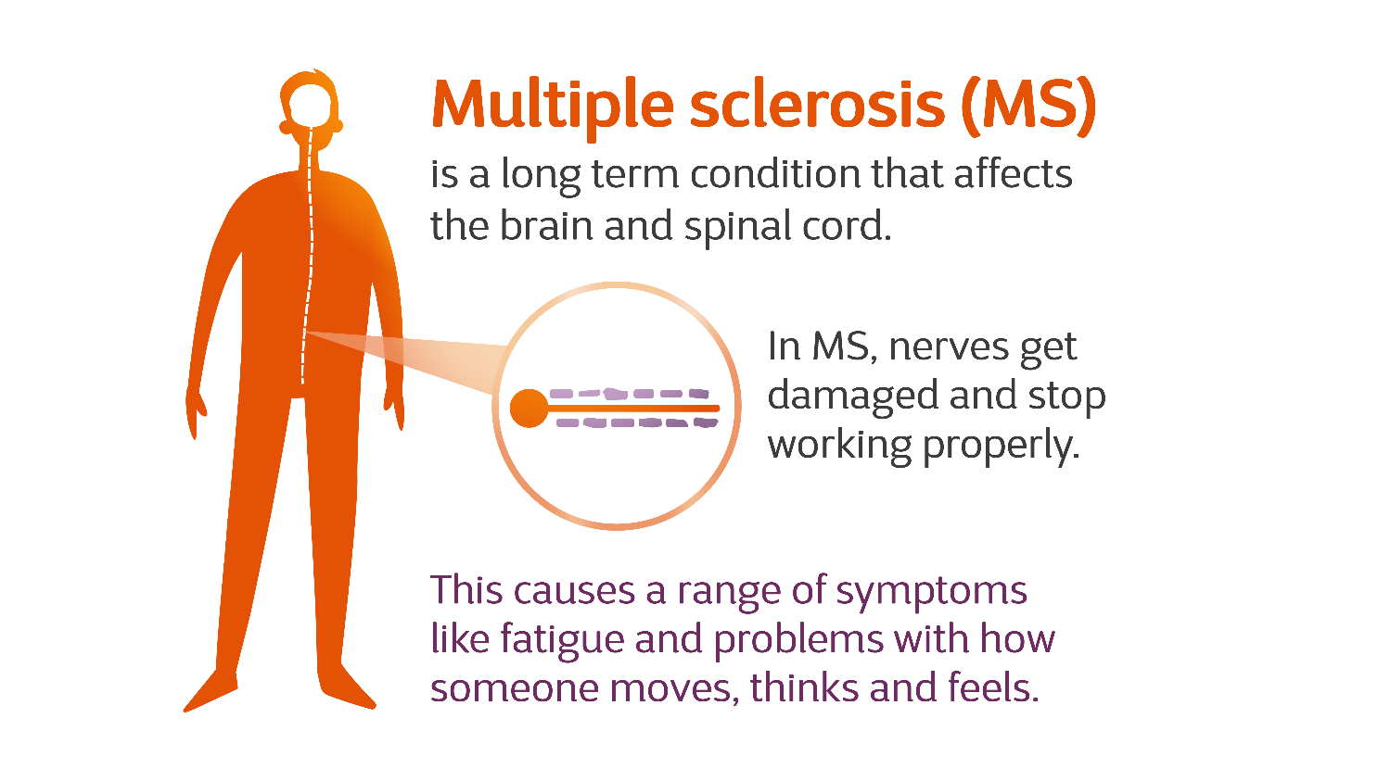
Notes:
What is MS?

Slide 11
My story
    Tell your story…
Notes:
Blank template slides for you to share your story of living with MS with stakeholders.

Slide 12
My story
    Tell your story…
Notes:
Blank template slides for you to share your story of living with MS with stakeholders.

Slide 13
Stop MS Research – Why Now?
Notes:
For more information on the research slides, please see the our ‘research story’ on VolWeb.

Slide 14
Why the Stop MS Appeal?
    “I firmly believe we can change the outlook of MS. I hope in 10 years’ time, upon diagnosis, a person will be given a handful of pills to tackle all the various elements, and they will be offered hope that their life will be minimally affected by the condition.”
    Professor Alasdair Coles, University of Cambridge
Notes:
This quote comes from Alasdair Coles, a leading voice in MS research from the University of Cambridge.

Slide 15
What is the Stop MS Appeal?
    Research has got us to a critical point, and we must act now
    Our Stop MS appeal needs to raise £100 million to find treatments for everyone with MS. We can see a future where nobody needs to worry about MS getting worse
    By 2025 we plan to be in the final stages of testing a range of treatments for everyone with MS
    We believe we can Stop MS, and you can help!
Notes:
Research has got us to a critical point, and we can see a future where nobody needs to worry about their MS getting worse. But we need to act now, because people with MS can’t wait.
By 2025, we plan to be in the final stages of testing a range of treatments for everyone with MS.
To fund this essential research we need to raise £100 million over ten years.
With what we know, we can drastically reduce the impact of MS, so everyone can live their lives with more certainty and hope for the future.

Slide 16
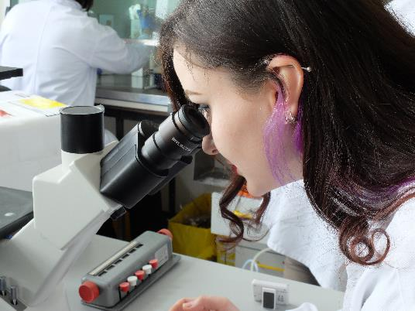
Where are we now?
    There are over a dozen treatments for people with relapsing forms of MS, but there are still lots of people without treatment
    Treatments that do exist only work on one aspect of MS: the immune system
    To help people at every stage, we need to find treatments that stop the progression of disability in MS
Notes:
There are over a dozen licensed treatments for people with relapsing forms of MS, and some emerging for early active progressive MS. But there are still lots of people without treatment. Treatments that do exist only work on one aspect of MS: the immune system.
To help people at every stage of MS we need to stop MS progression.

Slide 17
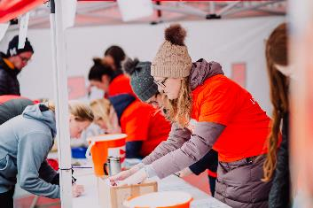
Where could we be?
    Research in recent years has transformed our understanding of progression and how the body responds to MS damage
    We are translating what we know about stopping immune attacks, repairing myelin, and protecting nerves into ways to find treatments that slow or stop MS progressing
    Treatments that slow or stop disability for everyone with MS are now a very real prospect
    To fund these discoveries, we need to raise £100 million over the next ten years
Notes:
Learning exactly what goes wrong in MS is enabling us to develop strategies to stop that from happening.
Two critical things we have learned:
Myelin damage
When myelin is damaged it stops our nerves working properly. Messages from the brain and spinal cord to the rest of the body are disrupted, resulting in the many varied symptoms of MS.
Nerve loss
Once a nerve cell is lost it can’t be replaced, although our brain will try to manage without it. To slow or stop progression, we need to develop treatments that protect the nerves from further damage.

Slide 18


Treatment strategies
Immunomodulation
Stopping immune attacks
Neuroprotection
Protecting the nerve cell
Remyelination
Replace damaged myelin
Notes:
We are translating what we know about stopping immune attacks, repairing myelin, and protecting nerves into ways to find treatments that slow or stop MS progressing.
Three steps to Stop MS
Stop immune attacks
The initial immune system attack is what damages myelin and causes the symptoms of relapsing MS. This is what existing disease modifying therapies (DMTs) focus on.
Repair myelin
Our researchers have identified ways for the brain to repair myelin. We are working to translate these discoveries into a potential treatment that can be taken into clinical trials.
Protect nerves from damage
We now know more about how nerves are damaged in MS, and can look into potential new drug targets to keep nerves strong and resilient.

Slide 19
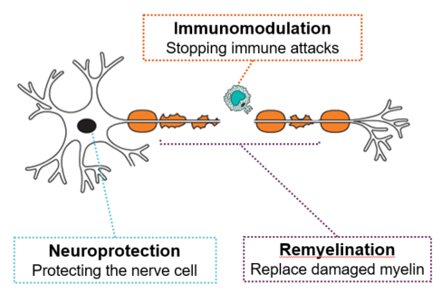
Where will the funds go?
    The money we raise will fund critical research projects including:
      A first-of-its-kind MS clinical trials platform to test and deliver effective treatments for people with progressive MS as quickly as possible
      Funding more innovative and groundbreaking projects in the UK
      Supporting vital research infrastructure and programmes like the MS Society Tissue Bank, the MS Society Cambridge Centre for Myelin Repair, the MS Society Edinburgh Centre for MS Research, and the UK MS Register
Notes:
We can see a future where nobody needs to worry about MS getting worse. The money we raise will fund critical research projects including:
A first-of-its-kind MS clinical trials platform to to test and deliver effective treatments for people with progressive MS as quickly as possible.This is currently being designed and developed by an Expert Consortium of the brightest minds in science.
Funding more innovative and groundbreaking projects in the UK through our responsive grant round and fellowships that support the best MS researchers
Supporting vital research infrastructure and programmes like the MS Society Tissue Bank, the MS Society Cambridge Centre for Myelin Repair, the MS Society Edinburgh Centre for MS Research, and the UK MS Register

Slide 20
The Stop MS Appeal

Slide 21
The film…
Notes:
MS research is ready, and so are we.
You can find the film here. You can also embed it into the slides if that works better for you.
https://www.youtube.com/watch?v=BSiSiQKssno
The film features four people with MS who you will see lots of throughout the appeal. They are people living with MS from across the country.
Donna, Coordinator of Asian MS. She has relapsing MS and has had MS since she was 17. She’s now 34 years old. Donna lives just north of Birmingham.
Glyn, progressive MS, from Cardiff, in his forties. Glyn is on our Cymru Council. He’s married to Mark and in for build-out content for the campaign, we’ve interviewed both of them talking about their relationship and how MS has affected it.
Nikki, from Warwickshire, relapsing MS, 52 years old. Nikki is one of our RBS Ambassadors. She’s married and has a daughter.
Jacqueline from Northamptonshire, 57, progressive MS. She has two children – one of whom is Ed, who’s 23 and has a small part in the film. He was also photographed with his mum for the ad, and again, for the build-out content we’ve interviewed them together. Jacqueline has been involved in the private phase of Stop MS.

Slide 22
Notes:
Our campaign features six people living with MS and two family members. In addition to Donna, Nikki, Jacqueline (and her son Ed) and Glyn (and his partner Mark) who you saw in the film, we have Alastair and Charlotte.
Charlotte, 31, from Glasgow, is a professional musician and teacher. She was diagnosed with relapsing remitting MS in 2018 and lives with her husband and daughter.
Alastair is the group coordinator of the Coleraine MS Society group along with his wife Gillian. He is 53 and living with progressive MS.
You can hear more about their stories, their experiences of living with MS and their hopes for the future of MS research on our website and social media.

Slide 23



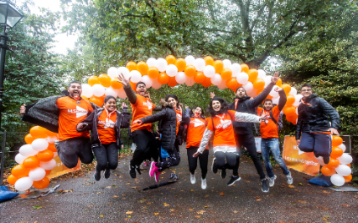
Coverage on different channels
    Coverage in local and national newspapers
      Including a partnership with the Telegraph
    TV and cinema
      Our advert has been on Channel 4
    Digital and print marketing
    We’ll be promoting on our website and social media
    Email and direct marketing
    We launched with a series of events in England, Wales, Scotland and Northern Ireland
Notes:
MS research is ready, and so are we.
For roughly twelve weeks we will be promoting content across:
TV and cinema (including being featured on Channel 4)
UK wide press (including a partnership with lots of coverage in the Telegraph)
Digital and print marketing
The Telegraph newspaper partnership (print and digital)
Our own social media channels, website and email

Slide 24
Team Stop MS – Will You Join Us?
Notes:
MS research is ready and so are we. We’re in the best place we’ve ever been to find
life-changing treatments for everyone with MS. Our Stop MS Appeal need to raise £100
million, because by 2025, we want to be in the final stages of testing treatments for everyone
with MS.
But we can only do this together. Are you up for joining Team Stop MS?

Slide 25

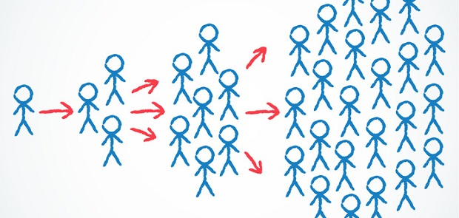
Two main ways you can get involved
Play a part in helping to reach £100 million to stop MS.
Spread the word!
Notes:
You are the most important part of the Stop MS Appeal. You’ll have a huge part to play in:
Spreading awareness
Raising money
Reaching people who do not yet support the MS Society

Slide 26
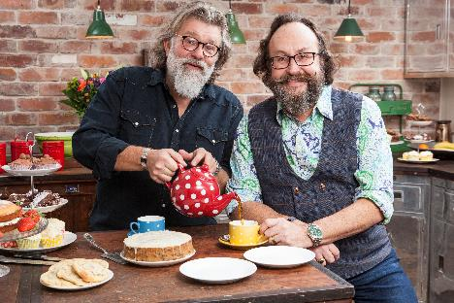
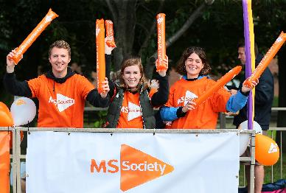
How can I get involved?
    We are all part of Team Stop MS. How you get involved is up to you
    Spread the word on social media and with your local networks
    Raise money locally or individually. Here are a few ideas:
      My MS Walk – host an MS walk where you are
      Cake Break – join the Hairy Bikers and host a cake break
      The Big Leap – get your adrenaline flowing with a sponsored sky dive
    Take part in our MS Walks
    Get creative!
Notes:
In addition to spreading the work on social media and with your networks. There is a world of fundraising opportunities.
My MS Walks are an accessible way to get involved and fundraise to stop MS. The walks can be any distance or size and we have lots of resources available to support you
The second way you can fundraise to stop MS is Cake Break. It’s a really quick and easy way to raise money, and something we know lots of people do already. Fundraising packs are available.
The other way to fundraise, if anyone’s feeling more adventurous, is skydiving! We have lots of people living with MS who skydive, as it’s really accessible. It’s also something you can do across the UK at any time of year.
If we are going to raise £100 million to stop MS, we also need to get creative!
Could you:
Paint your social media 'Stop MS’?
Donate time, money, energy?
Bake, walk, ride, zip-slide for MS?
Share your story, share someone else's story, tell someone you’re there for them?
Come up with all the amazing things we haven’t thought of?
Team Stop MS is for anyone and everyone.

Slide 27
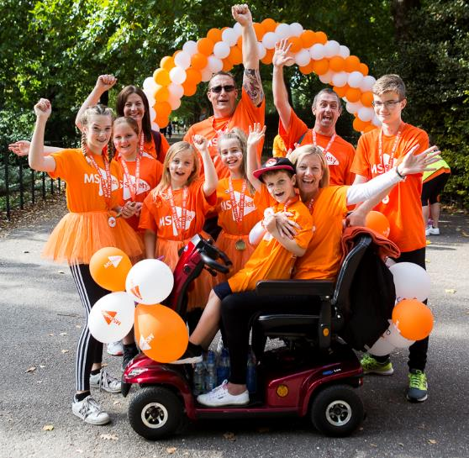

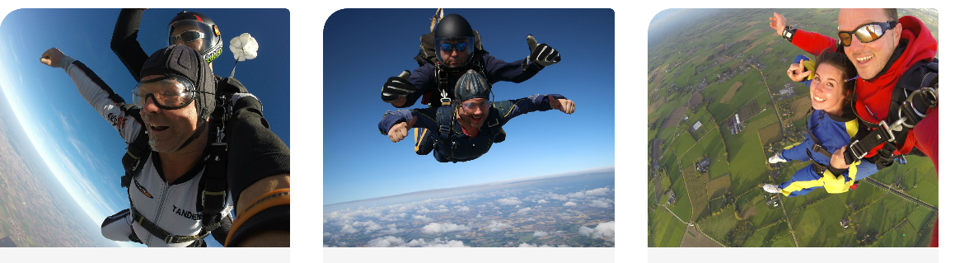

Slide 28
The MS Society – Who are we?

Slide 29
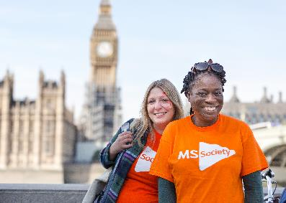
Who are we?
    We’re the MS Society – a community of people living with MS, scientists, campaigners, volunteers and fundraisers
    We understand what life’s like with MS, and we support each other through the highs, lows and everything in between
    We’re researching, writing, campaigning and fighting. Running, walking, caring and talking. And we’re driving research into more – and better – treatments. For everyone
    Together, we are strong enough to stop MS
Notes:
In addition to spreading the work on social media and with your networks. There is a world of fundraising opportunities.
My MS Walks are an accessible way to get involved and fundraise to stop MS. The walks can be any distance or size and we have lots of resources available to support you
The second way you can fundraise to stop MS is Cake Break. It’s a really quick and easy way to raise money, and something we know lots of people do already. Fundraising packs are available.
The other way to fundraise, if anyone’s feeling more adventurous, is skydiving! We have lots of people living with MS who skydive, as it’s really accessible. It’s also something you can do across the UK at any time of year.
If we are going to raise £100 million to stop MS, we also need to get creative!
Could you:
Paint your social media 'Stop MS’?
Donate time, money, energy?
Bake, walk, ride, zip-slide for MS?
Share your story, share someone else's story, tell someone you’re there for them?
Come up with all the amazing things we haven’t thought of?
Team Stop MS is for anyone and everyone.

Slide 30
Questions?

Slide 31

Thank you

