Slide 1
When to use this presentation
This presentation covers who we are and what we do.
Please use these slides when introducing the MS Society to a new audience.

Slide 2



How to use this slide deck
Only make changes to the presentation on your saved copy.
You can hide slides by clicking this icon:
You can add extra slides by clicking this icon:
Please read the slide notes by clicking this icon:
Notes:
You can edit these slides, remove or add slides to make them work for your own presentation
There’s a slide at the end to add in information about your group
NB. Remember when sharing to click the Slide Show button on the bottom toolbar so that the notes on the slides are not visible to the audience when you're presenting

Slide 3
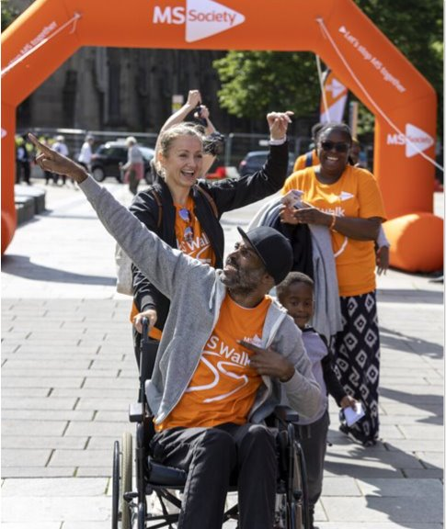
Introducing the MS Society
[Add your name and group name here]
Notes:
Only make changes to the presentation on your saved copy.

Slide 4
About the MS Society

Slide 5
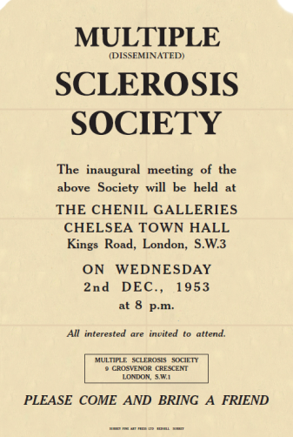
Our beginning
In 1953, our founders Richard and Mary Cave were frustrated at the lack of treatments and support available for Mary's MS. So they decided to do something about it.
They set up their first meeting in West London, a small number of people came and the MS Society was born.
Today, we have around 240 volunteer groups in every part of the UK. Richard and Mary’s work has inspired thousands of volunteers, supporters and staff members to make a difference to the lives of people affected by MS.

Slide 6
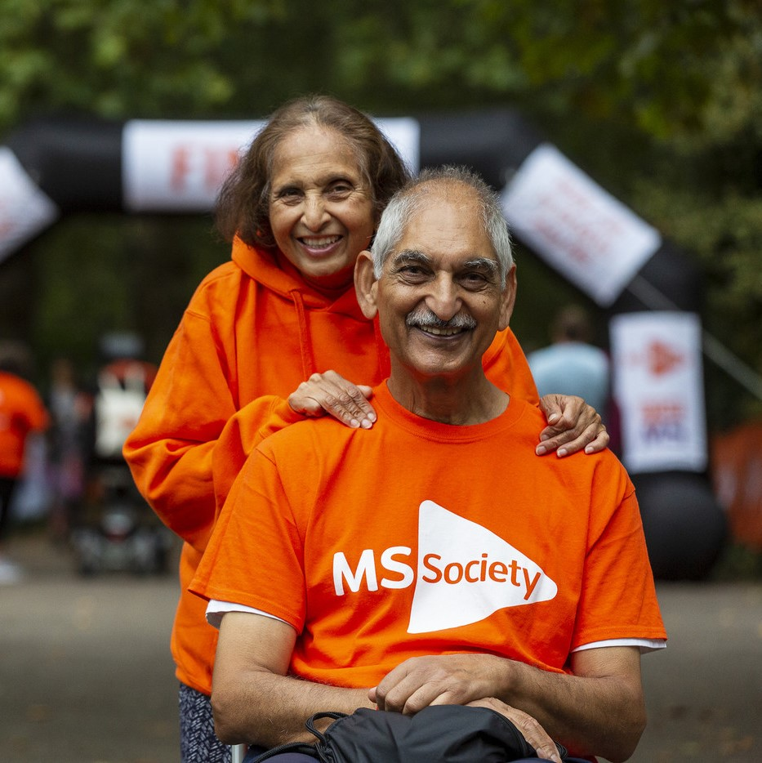
Our mission: Transforming lives, stopping MS
Our vision is a world free from the effects of MS.
Our goal is to find treatments for everyone.
Until then, we're working to make sure no one has to face MS alone.
Everything we do is guided by people with MS. Because together, we're stronger.

Slide 7
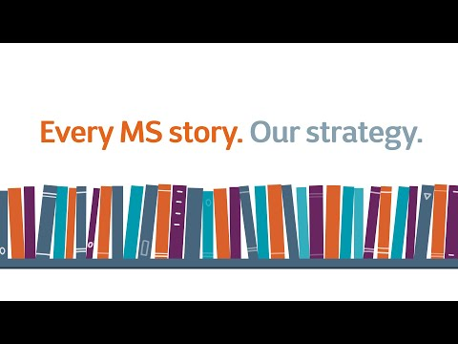
Our strategy
Notes:
Our work is guided by our strategy. It sets out what should be better if you’re living with MS in the UK, and how we’re going to get there.
Everyone living with MS, their family and friends has a unique MS story. We listened to your stories. We asked what was most important to people. We looked back at our 2015 to 2019 strategy to see where we’d tackled those things. And where we still have work to do.
We want a world free from the effects of MS. And we have a bold, ambitious plan to help get us there.

Slide 8
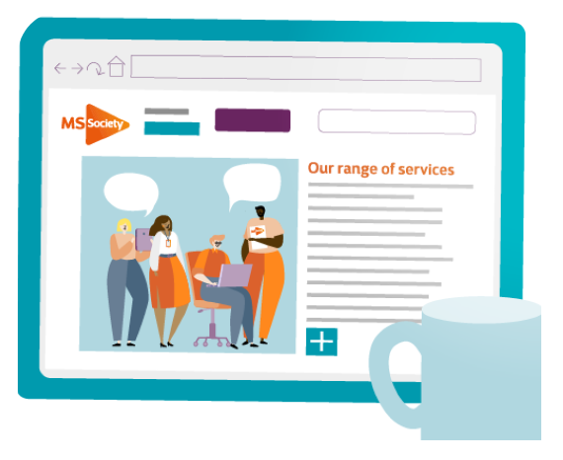
Our long-term goals
Helping people to live well with MS.
Supporting: people with MS, carers, families and friends.
Fighting for treatments, care and support across the UK.
Notes:
Supporting people living with MS. We want people with MS to live well with their condition. We’ll continue to expand our range of services to help people understand their rights, manage their condition and do the things in life that are important to them.
Supporting carers, families and friends We know that MS is tough on carers, families and friends. We’ll provide the best quality information to help people understand MS and their rights as carers. And we’ll keep developing the support we offer, to help everyone’s health and wellbeing.
Access to responsive treatments, care and support We’ll be fighting to make sure everyone can access the treatments, care and support they need, wherever they live in the UK. We want the policies made by governments, and the health care people get, to reflect what people with MS, their family and friends go through day to day.

Slide 9

Our long-term goals
Connecting people and making sure their voices are heard.
Raising awareness of the challenges people living with MS face.
Connecting MS communities, so that no one feels alone.
Providing the tools so that people affected by MS can lead the change.
Notes:
Improving society’s understanding of MS. MS is different for everyone and many symptoms are invisible. People living with MS often face barriers and challenges in everyday life. We’ll raise awareness and increase public and political understanding of the realities of MS.
Connecting MS communities. We don’t want anyone to feel alone, overwhelmed or misunderstood. We’ll increase the ways people can share experiences, tackle common issues, foster friendships, build confidence and reduce isolation.
People affected by MS leading change. We want to support MS communities to become movements for change on issues that affect them. We’ll help people living with MS to develop the skills and confidence to speak up on issues they care about. And we’ll provide the tools people need to run campaigns that bring about real change.

Slide 10

Our long-term goals
Working to find effective treatments and prevent MS.
Understanding how and why MS gets worse.
Developing treatments up to three times faster.
Finding ways to prevent people developing MS.
Notes:
Deepening our understanding of progression. For people with MS, not knowing how their MS will change over time is a huge challenge. We’ll be prioritising our work with UK and international partners to improve our understanding of how and why MS gets worse.
Accelerating clinical trials. We believe we can slow, stop or reverse the effects of MS, for everyone. And to get there we’re funding a first of its kind clinical trials platform to develop treatments up to three times faster than we do now.
Improve our understanding of risk factors. We’re still not sure what causes MS. But we want to understand the possible risk factors better, so we can develop ways to prevent people developing MS.

Slide 11

Our values
With the MS Community:
we're Bold
we're Expert
we're Ambitious
we're Together
And we commit to making sure we:
listen, learn and are led by our diverse MS communities
Notes:
It’s not just about what we say we’ll do. We know it’s also important that we work in the right ways. Our BEAT values are at the heart of how we work.

Slide 12
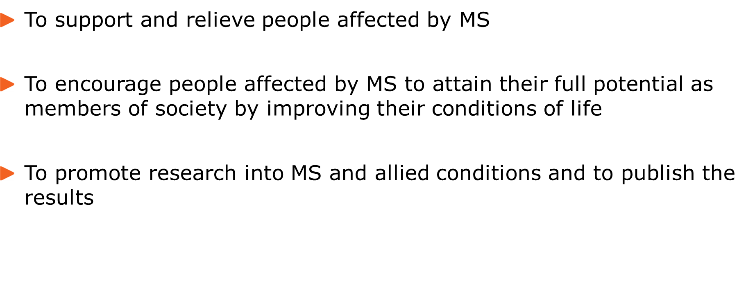
Our purposes
Notes:
Everything we do must be in pursuit of our charitable purposes, and must be for the benefit of people affected by MS in the UK.

Slide 13
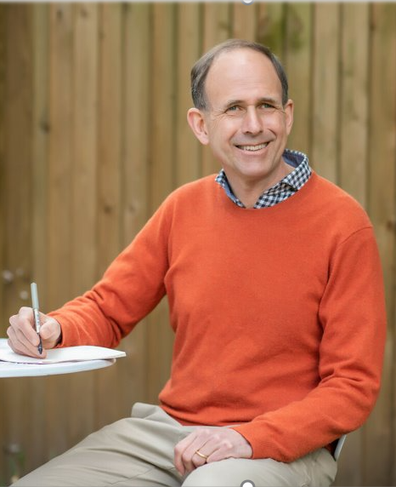
How are we run
Nick Moberly, our CEO
Our Board of Trustees are responsible and accountable for the organisation, they are volunteers.
They set our strategy and values, and agree and monitor business plans and budgets.
They appoint the CEO to manage our day-to-day running on their behalf.
Nick Moberly our CEO manages the Executive Group, who are responsible for delivering our strategy.​

Slide 14
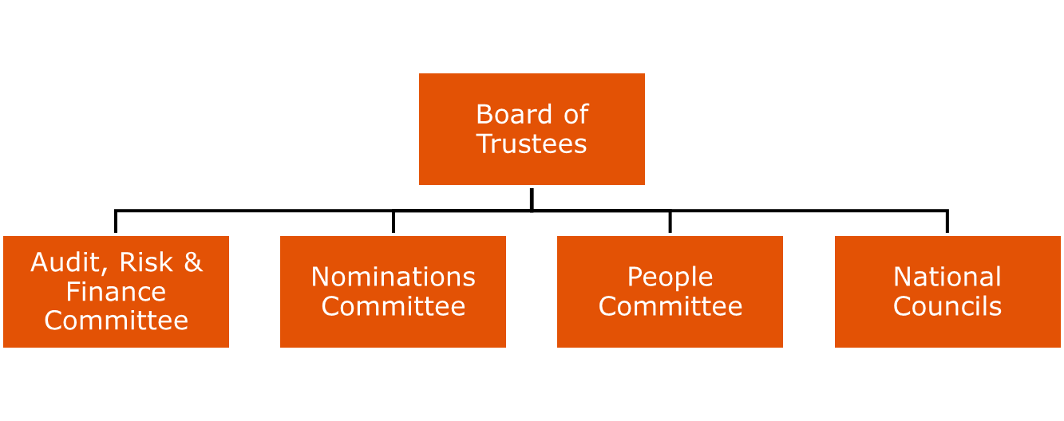

Governance structure
Notes:
Sub-committees provide a deeper level of scrutiny for the board in key areas.
Audit, Risk and Finance Committee looks at our financial performance, risk management and ensures we have appropriate internal controls etc. in place.
Nominations Committee oversees governance appointments (trustees and councils) and board performance and other governance requirements.
People Committee has oversight of all people matters (employees and volunteers), keeping strategic oversight of areas like staff engagement, pay and benefits and the recruitment of the CEO.
National Councils provide a connection to the MS community throughout the UK. They ensure people affected by MS get their voices heard, and that the Board understands issues and priorities in the different nations.

Slide 15
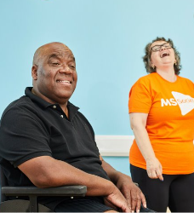
Our people
We're the UK’s biggest MS charity, but we wouldn't be able to do anything we do without our supporters.
3,000 volunteers, who are the backbone of everything we do.
240 volunteer led groups supporting people with MS locally.

Slide 16
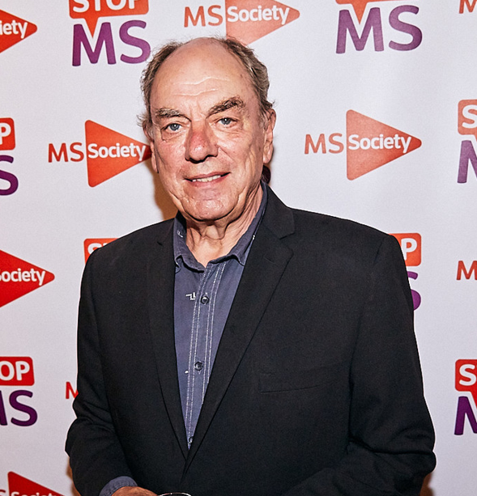
Our people
Alun Armstrong
300 employees working in all four nations of the UK.
11 ambassadors, high-profile supporters, who volunteer their time and energy to help stop MS.
Together we're researching, fundraising, campaigning and speaking up to stop MS.

Slide 17
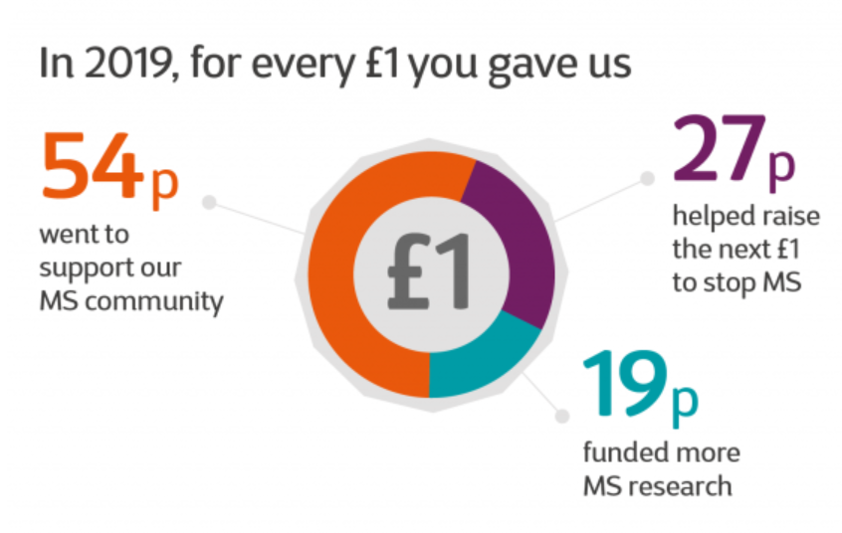
How we are funded
We couldn't do any of this without our amazing community's fundraising, donations and legacies.
Thanks to the support of thousands of supporters like you across UK, we can provide information, support and services to people living with MS, and fund millions in research each year.

Slide 18
What is MS?

Slide 19
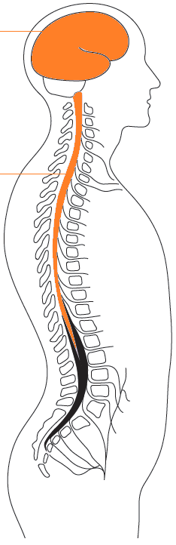
The biology of MS
brain
Multiple sclerosis (MS) is a condition that affects your brain and spinal cord.
In MS, the coating that protects your nerves (myelin) is damaged. This causes a range of symptoms like blurred vision and problems with how you move, think and feel.
spinal cord

Slide 20
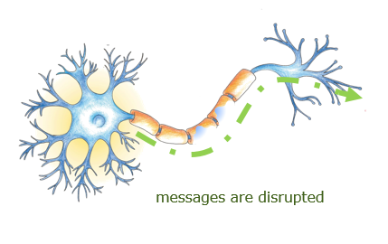
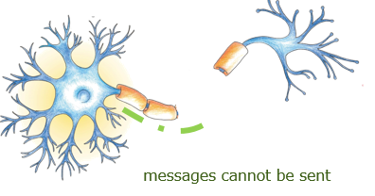
What happens in MS?
Myelin protects the nerve fibres in the central nervous system, which helps messages travel quickly and smoothly between the brain and the rest of the body.
In MS, your immune system, which normally helps to fight off infections, mistakes myelin for a foreign body and attacks it.
Myelin damage
Progression in MS

Slide 21
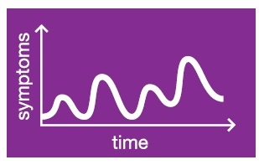
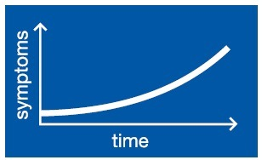
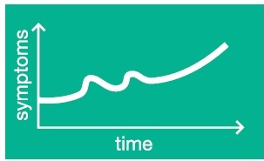
There are three different types of MS
Relapsing remitting
Primary Progressive MS
Secondary Progressive MS
Notes:
Relapsing remitting MS is a type of MS where you have relapses (symptoms getting worse) followed by recovery (that’s when it’s “remitting”). Your disability doesn’t get worse between relapses but after each relapse it can end up worse than before. Taking a disease modifying therapy could mean fewer relapses and slow down your MS.
Secondary progressive MS is a stage of MS which comes after relapsing remitting MS for many people. With this type of MS your disability gets steadily worse. In the past, before disease modifying therapies came along, it took around 20 years for relapsing MS to change into secondary progressive MS. But thanks to today's MS drugs this is changing: fewer people are likely to go on to secondary progressive MS and for people who do, it could take longer to happen.
Primary progressive MS is called this because from the first, or primary, symptoms it’s progressive. It’s usually diagnosed in people in their 40s. There will usually be few or no relapses. Instead, disability will gradually increase. There can also be long periods where symptoms seem to be staying level.

Slide 22
Why do people get MS?
Genes and family history
Over 200 genes linked with a risk of MS
But no single gene causes MS
Environmental factors
Infections may trigger MS
Vitamin D deficiency increases risk
Lifestyle factors
Smoking increases risk of progression
Obesity increases risk of diagnosis
Occupational hazards e.g. solvents
We don’t know why people get MS. No single factor causes it.
Scientists think a mix of genetic, lifestyle and environmental factors work together to cause the condition in some people.

Slide 23
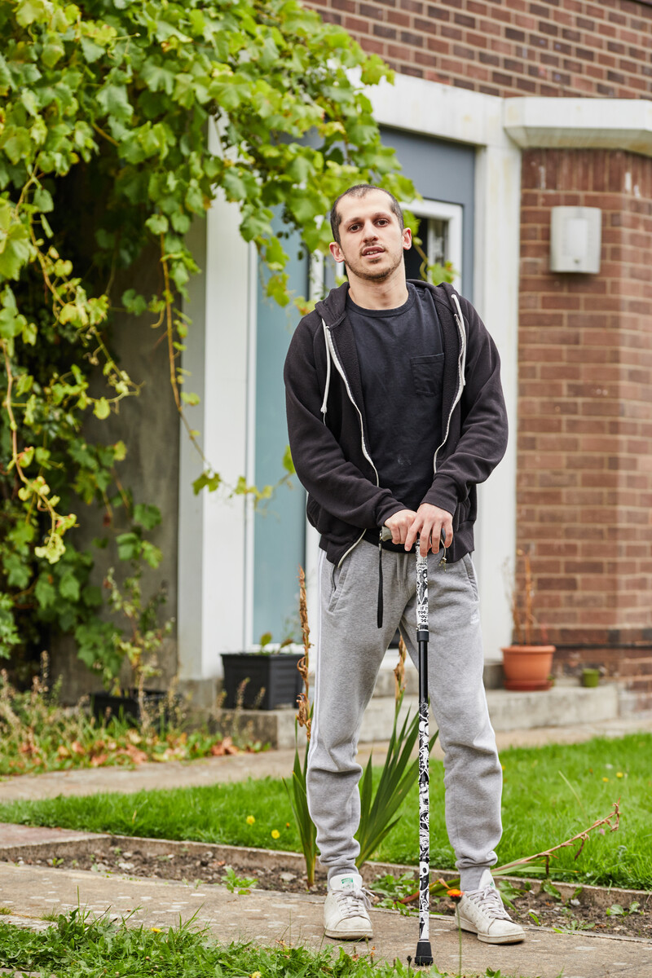
How it affects people
Fatigue (not just usual tiredness though)
Sensory problems
Muscle stiffness and spasms
Visual problems
Problems with walking, balance and coordination
Cognitive problems
Pain
Difficult to detect
Difficult for others to understand
Frustrating for the person to describe
May lead to further difficulties (at work, socially, etc)
Notes:
MS affects everyone differently. Even if you have the same type of MS as someone else, you probably won't experience the same symptoms in the same way.

Slide 24
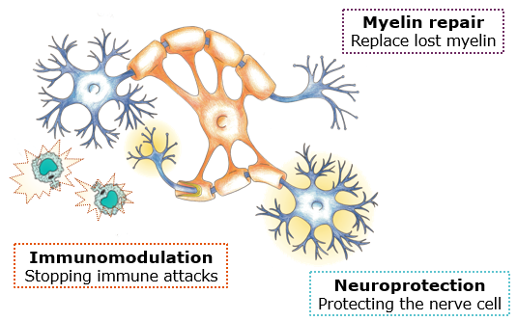
Can we stop MS?
There are three things that researchers are working hard on to stop MS.
Stopping immune cells from attacking myelin in the first place – called immunomodulation
Finding ways to repair and replace damaged myelin.
Protecting nerve cells from further damage, which is called neuroprotection.
Our vision is that a combination of these three things will be able to slow or stop the progression of MS.

Slide 25
Our work

Slide 26
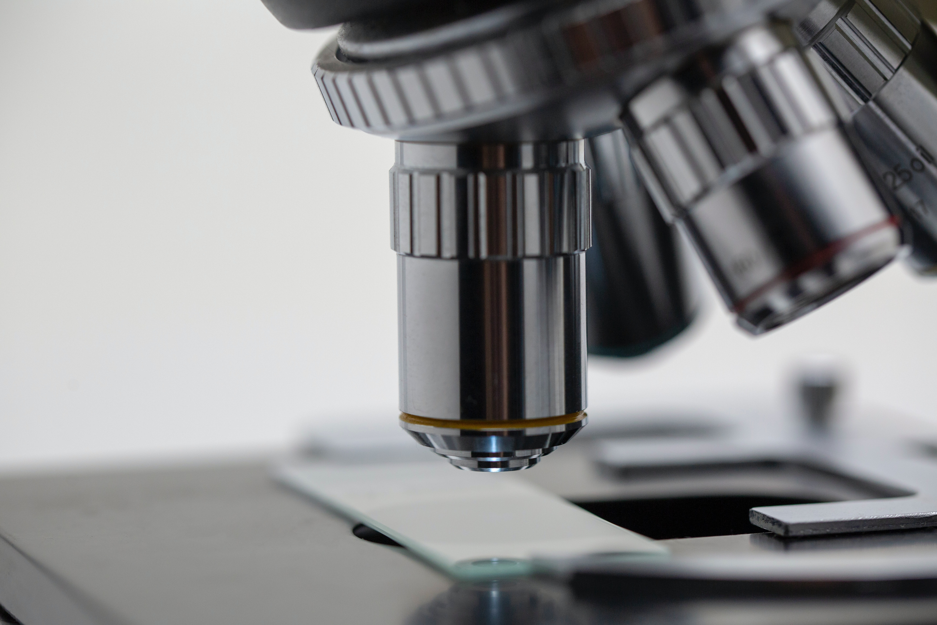


Research successes
Since our foundation in 1953, we’ve invested over £227 million in research, which has led to significant progress in MS treatments.
Historic milestones include:
Establishing the MS Society Tissue Bank
Founding two world-class MS research centres
Launching the UK MS Register
Notes:
The MS Society Tissue Bank allows people to donate their brain and spinal cord tissue for MS research after their death. It's a vital resource, with donated tissue helping scientists around the world advance our understanding of MS.
Our two Centres of Excellence in Cambridge and Edinburgh focus on developing treatments for the tens of thousands of people living with progressive MS in the UK, who currently have nothing to stop their disability getting worse.
The UK MS Register is the world’s first register, for any condition, to combine information from people about their MS, with clinical and NHS data. Since its launch in 2011, it’s formed an incredibly accurate picture of life with MS in the UK. We use this vital information to fuel campaigns for fair, relevant policy and improved health care.
To find out more about the research we fund check out our website: mssociety.org.uk

Slide 27
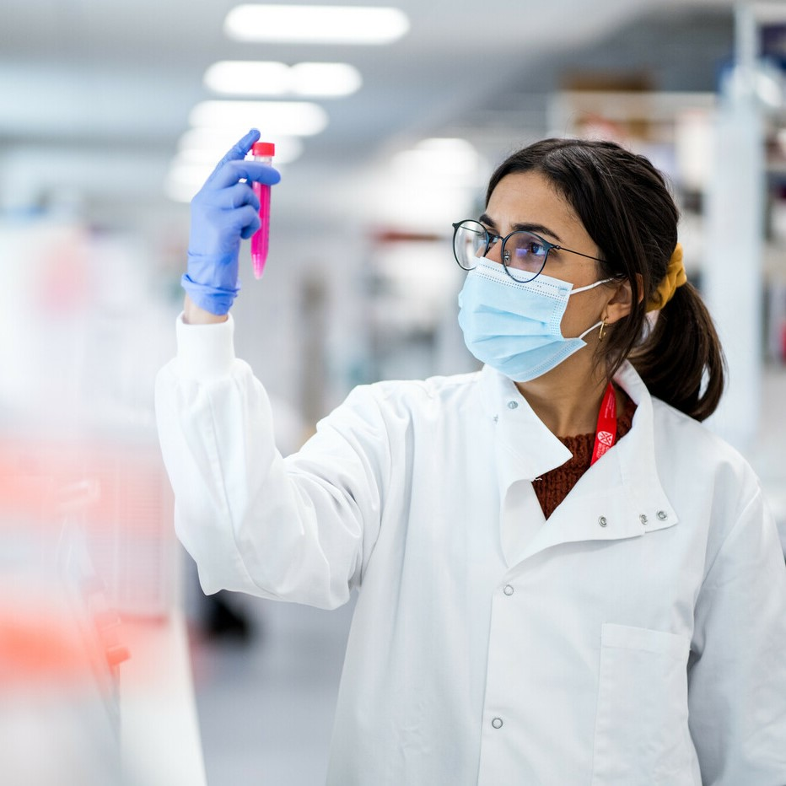

Current Research
Current funding projects include:
Octopus - an exciting new multi-arm, multi-stage trial for progressive MS.
ChariotMS – the first trial focusing on people with advanced, progressive MS – to see whether a particular drug can slow the worsening of hand and arm function.
Notes:
Octopus is a smarter way of testing potential treatments, using a multi-arm, multi-stage design. Multiple drugs can be tested at once and compared to a single control group. Promising drugs then stay in the trial, and the others are dropped. Octopus could deliver life-changing new treatments up to three times faster.
ChariotMS is a trial testing whether a drug called cladribine can help people with MS maintain the use of their arms and hands. If it’s shown to slow the worsening of disability for people with advanced MS, it could mean this group of people will eventually have access to a treatment for the first time.

Slide 28

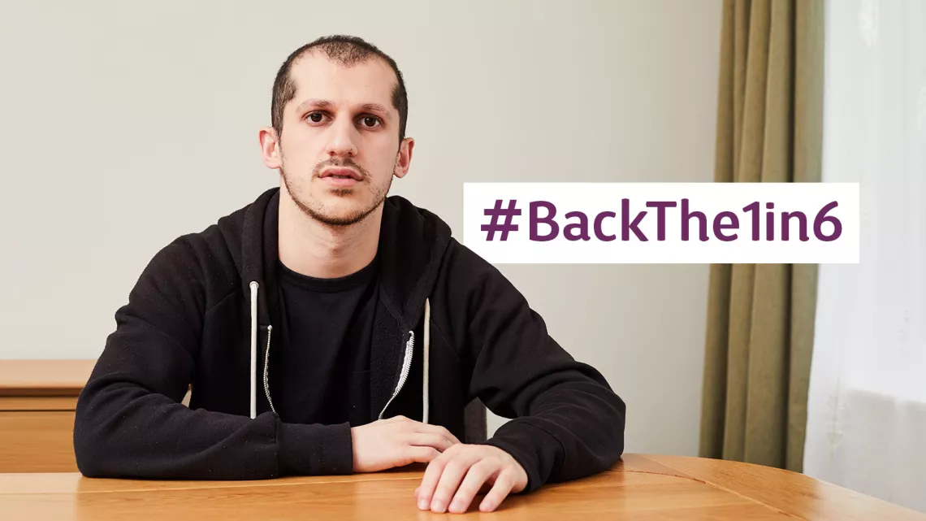
Our campaigns in 2022 included
Breaking Point
Employment without Barriers
Adult Disability Payment
The Carer's Leave Bill
Approved but Denied
PIP 20-metre rule
1 in 6 Campaign

Slide 29
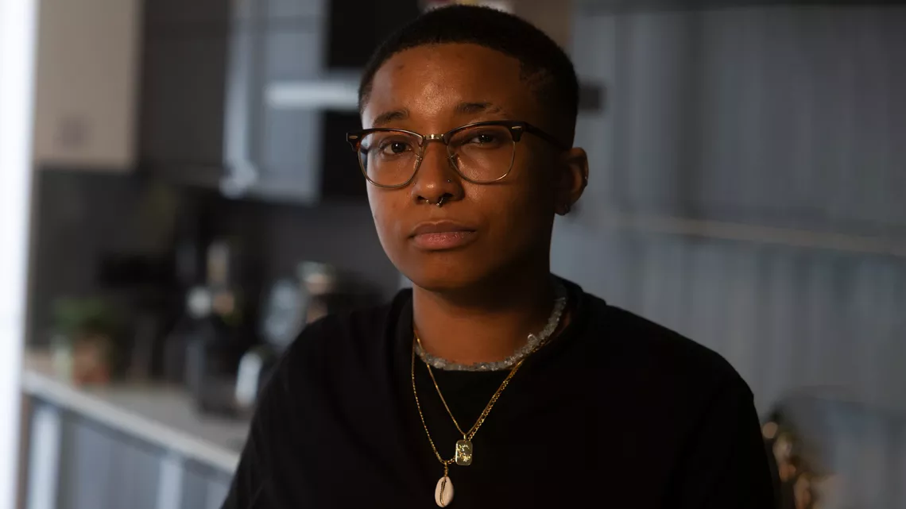

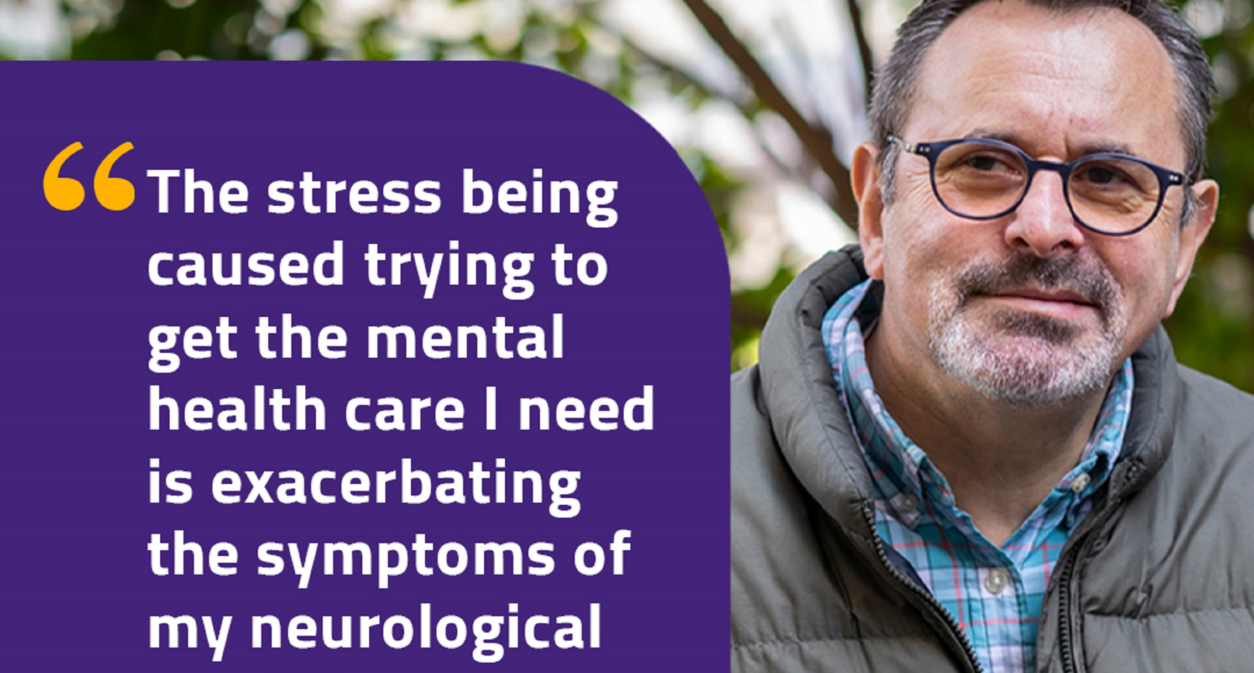
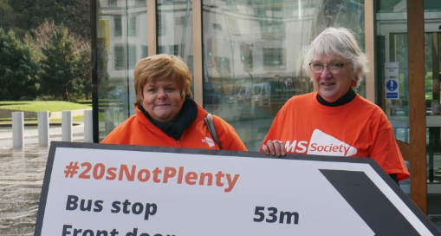
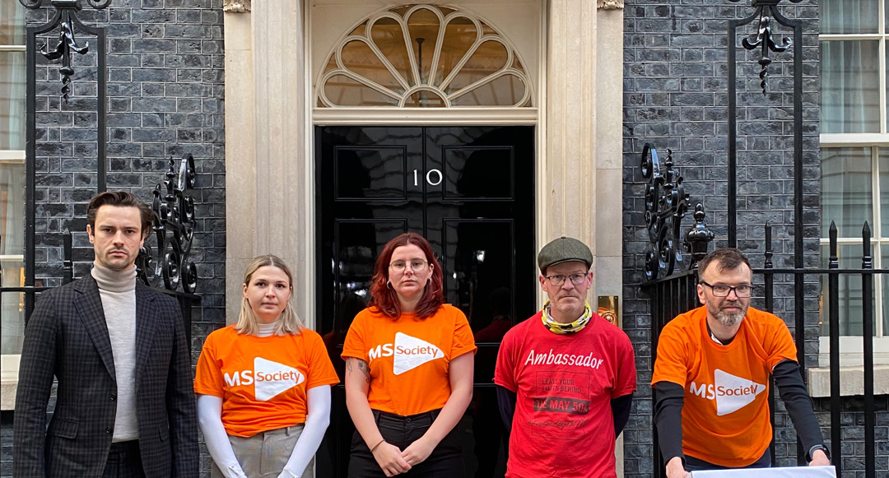
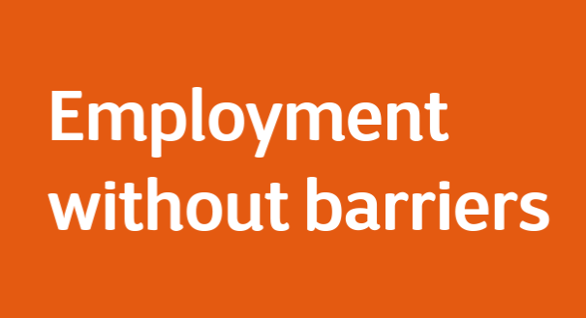
Our campaigns
Notes:
Too many people affected by MS in the UK must fight for the treatments, services, care and support they need. Our national and local campaigns help change this.
Our Breaking Point campaign called for the benefits system to better reflect the needs of people with MS. Over 14,000 people joined our campaign and we handed in our petition at Downing Street. The government agreed to increase benefits in line with inflation and provide new cost of living payments next year.
We worked with the All Party Parliamentary Group (APPG) for MS to publish a report called ‘Employment without Barriers’. The report makes recommendations for the UK Government to improve support for people with MS. So they can enter, remain in, and leave work when it’s right for them to do so.
In 2022, the Scottish Government began reviewing the mobility component of Adult Disability Payment. This review came about following our campaign calling for the 20 metre rule to be scrapped.
The carer's leave Bill aims to enable unpaid carers to balance their caring responsibilities with work by making sure employers give them extra time off. We are now campaigning to extend this Bill to provide paid leave and we’ll continue our campaigning work until the Bill becomes law.
Previously, Scotland was the only nation in the UK where Sativex was not recommended for use. This changed following our Approved but Denied campaign.
The PIP 20-metre rule is a measure of mobility which means that people who can walk even the smallest distance over 20 metres can’t receive the enhanced mobility rate of Personal Independence Payments. Our action to change this included creating a suite of video testimonies to form part of Disability Assessors’ online training.
Too many people with MS don’t get the care they need and services vary across the UK. We joined with other neurological charities to launch the 1 in 6 campaign. Together, we launched a petition that sets out clear recommendations for how to improve neurology services.

Slide 30
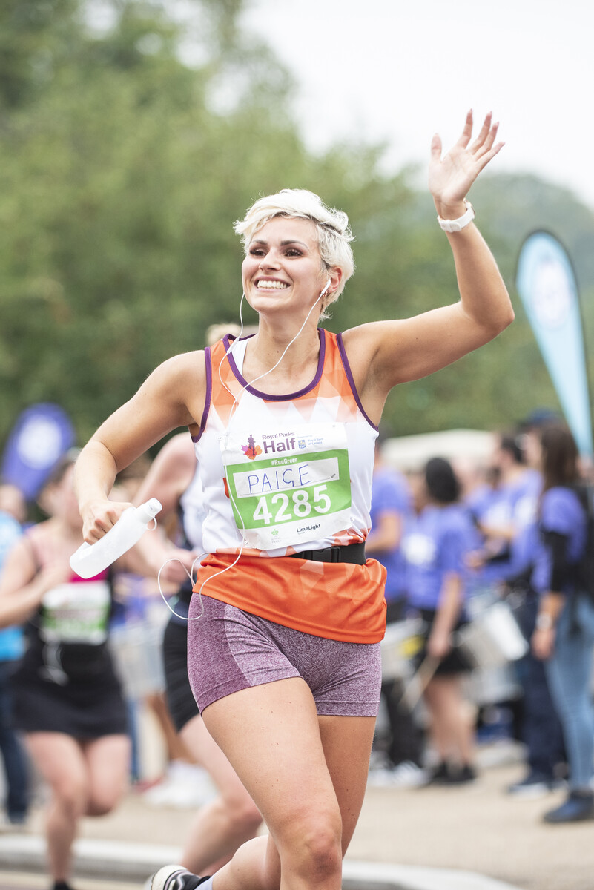
Fundraising
Our ambitious Stop MS Appeal aims to raise £100 million by 2025– to revolutionise treatments and change the course of MS for everyone.
My MS Woof – £28,000
May 50K - £2,046
Game Over - £4,250
Running events - £1,283,258
Carols by Candlelight - £54,000
Notes:
In 2022, our amazing supporters raised money for us through all manner of activities. Ten-year-old Maisie shaved her hair off, and Stuart completed a 600-mile walking tour of Premier League football stadiums.
These contributions complement what we raise through our centrally-organised events. In 2022, these included:
My MS Woof is our dog walking challenge. We asked our paw-some supporters to walk, roll or stroll with their pooches to help stop MS.
For our May 50K, supporters decided when where and how to complete 50K during the month of May — depending on their fitness and mobility levels.
Game over is where our supporters use their gaming to fundraise for us by holding fundraising livestreams, organising gaming tournaments or tackling sponsored challenges.
Marathons/running events Last year our MS Superstars raised over £1,000,000 by getting their running shoes on.
We ended the year with Carols by Candlelight — our annual concert of festive music, with readings from special celebrity guests.

Slide 31
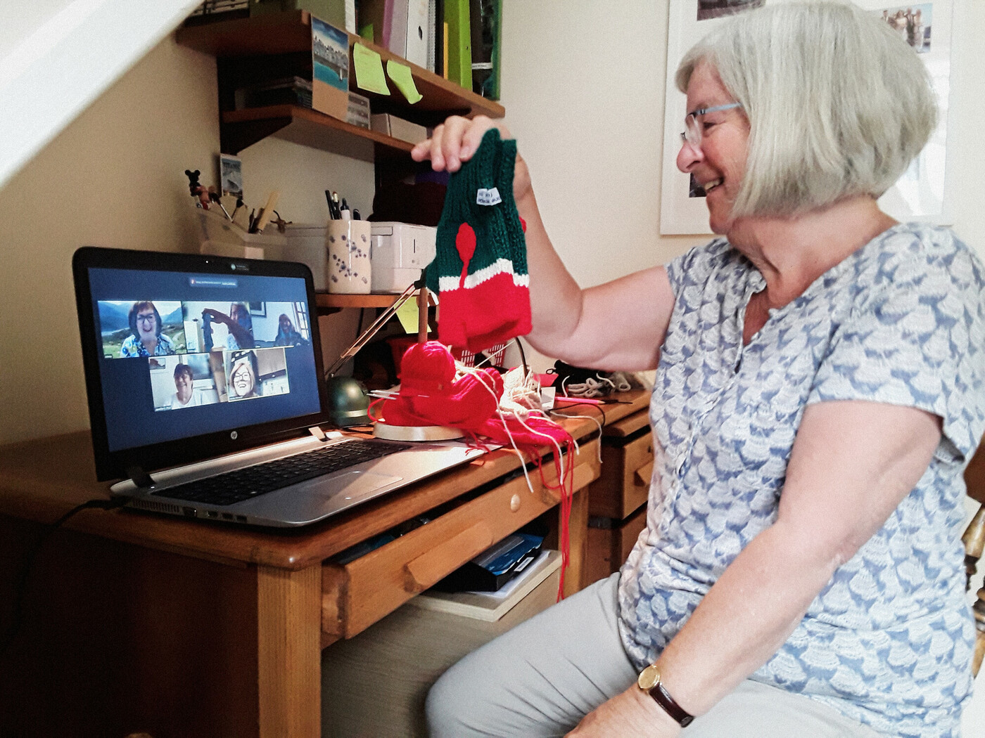
Supporting our community
Supporting the MS community is one of the most important things we do, whether that’s by providing practical information or giving emotional support.
MS Helpline
Wellbeing Hubs
Monthly webinars and wellbeing group sessions
Volunteer-led groups
MS Society website and information booklets
Tool to explore disease modifying treatments (DMTs) for MS
Notes:
In 2022 our award winning MS Helpline responded to over 25,000 calls, our MS Nurses responding to over 3,370 enquiries.
Through national and regional projects across the UK we've set up Wellbeing Hubs, running services to support both physical and mental health more locally.
We run monthly webinars with expert speakers on topics enabling people to live better with MS, and wellbeing group sessions online to bring people together.
Our 240+ volunteer-led groups also provide support, friendship and services to thousands of people affected by MS across the UK.
The MS Society website is packed with information about all aspects of MS, and our many booklets are available on request.
We have a DMT tool to help people with MS explore treatment options and prepare for conversations with health professionals. It asks a series of questions, then suggests treatments that seem a good match. We also have an online fatigue management tool.

Slide 32
About our groups

Slide 33
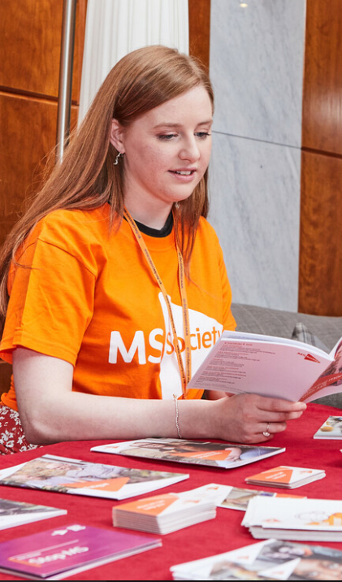
What do our groups do?
There are around 240 self-funded MS Society groups around the UK, all run by our dedicated volunteers.
All the groups are different, but they could include:
      Local information and signposting
      Talks from MS Nurses and other professionals
Emotional support
Exercise classes
Social activities and trips
Referrals for financial advice
Grants to individuals for mobility aids etc
Fundraising and campaigning opportunities

Slide 34
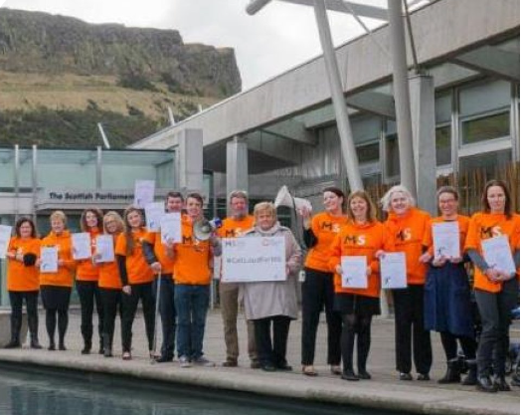
Our National councils
Our councils for England, Northern Ireland, Scotland and Wales work on behalf of people affected by MS in each nation of the UK.
Each national council has 12 - 15 members. They form a key link within each nation between the Board and the MS community.
Our council members contribute to the development of our strategy, develop annual plans, act as ambassadors and promote, develop and support volunteers.

Slide 35
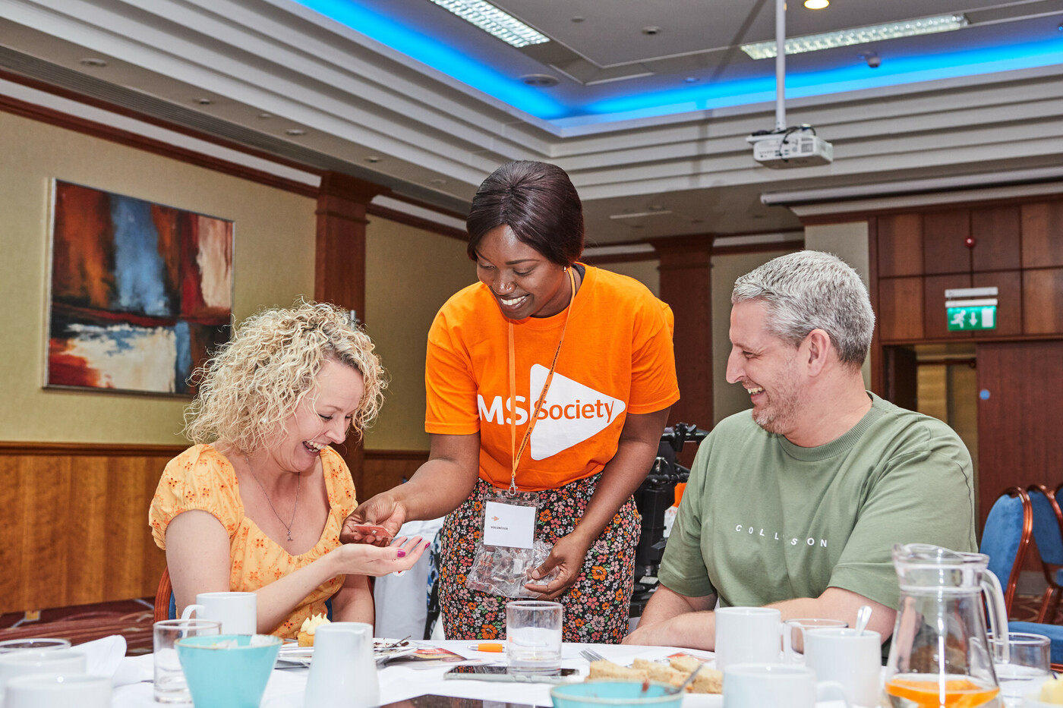
What do the [name] group do?
You might want to include here:
A bit of the history of your group
The services and activities you offer
How people can get involved

Slide 36
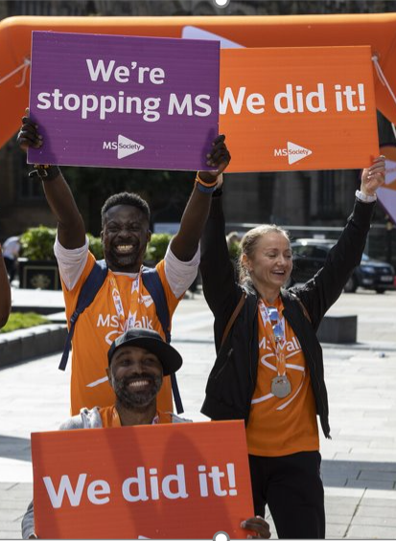
Get involved
We can’t achieve our goals on our own, so we need you to join us. Visit www.mssociety.org.uk/get-involved to find out how you can:
Join
Donate
Fundraise
Volunteer
Campaign with us

Slide 37
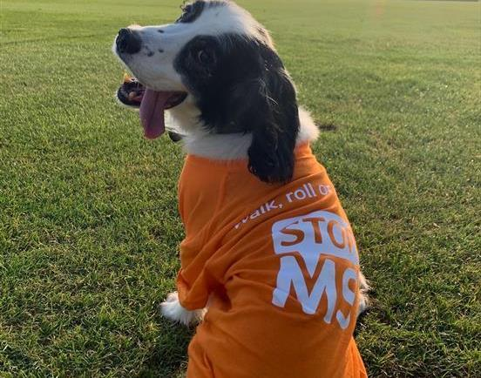
Thank you
Notes:
Instructions:
This is the “Thank you” layout. Type over the sample text.
To change the image, click on the example and press Delete key to empty the placeholder
Click on the “Pictures” button in the centre of the placeholder and choose an image to insert.

