Slide 1

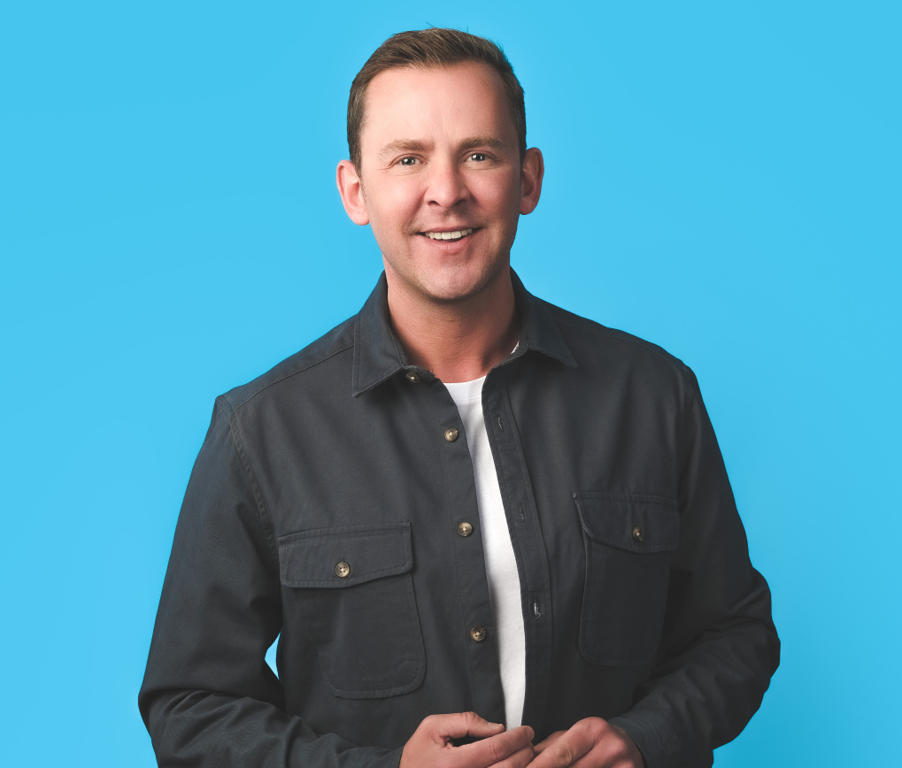
Scott Mills 1970s Quiz

Slide 2


A message from Scott...

Slide 3

Round 1:
General Knowledge
10 Questions

Slide 4
1) How many prime ministers did the UK have in the 1970s?
Bonus points – name them!

Slide 5
2) What was the best selling car of the 70s?

Slide 6
3) In what year was the first domestic microwave cooker sold?

Slide 7
4) Which festival had it’s first event in September 1970?

Slide 8
5) What year was the Sony Walkman released?

Slide 9
6) Where were the 1976 Summer Olympics held?
1 point country, 1 point city

Slide 10
7) Which crewed space mission was launched on April 11th 1970?
Clue: it intended to land on the moon, until an oxygen tank exploded, causing a loss of power, heat and drinkable water.

Slide 11
8) What important financial event happened in England in 1971?

Slide 12
9) It arrived in 1976 and could fly at 2,100 kilometres per hour. What was it?

Slide 13
10) Which 1974 event led to the resignation of President Richard Nixon, making him the first US President to resign from office?

Slide 14
Round 2:
70s Music
5 Questions

Slide 15
1) Which legendary British band released their final album in May 1970?

Slide 16
2) What was the best-selling single of the 1970s in the UK?

Slide 17
4) Bridge Over Troubled Water was the final album of which folk-rock duo?

Slide 18
3) Which Irish rock band sang The Boys Are Back In Town?

Slide 19
5) Which song from Grease sold the most singles in the UK?

Slide 20
Round 3:
TV and Film
5 Questions

Slide 21
1) Which iconic shark film was released in 1975?

Slide 22
2) In which real West Yorkshire town is the Last of the Summer Wine series filmed?
A. Holmfirth
B. Hebden Bridge
C. Hemsworth

Slide 23
3) What are the surnames of the Two Ronnies?

Slide 24
4) In which year was the first Star Wars film released?

Slide 25
5) Which mouse like creatures lived on the Hoot Planet?

Slide 26
Round 4:
1970s Food
5 Questions

Slide 27
1) What popular fast-food chain introduced the Happy Meal in the 1970s?

Slide 28
2) What type of salad became popular in the 1970s, consisting of iceberg lettuce, bacon bits, croutons and a creamy dressing?

Slide 29
3) What classic dessert featured layers of sponge cake, fruit filling, and whipped cream, often served in a glass dish?

Slide 30
4) Which popular British sweet was first launched in 1974 and is known for its colourful, bite-sized pieces with a hard sugar shell?

Slide 31
5) What 1970s snack, made from dehydrated potatoes, became a household staple?

Slide 32
Round 5:
Name that 70s toy!
5 Questions

Slide 33
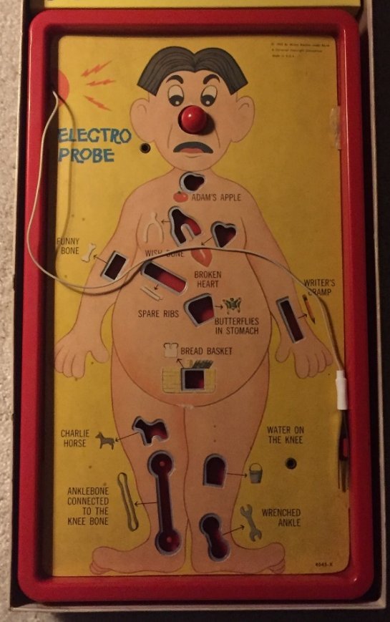
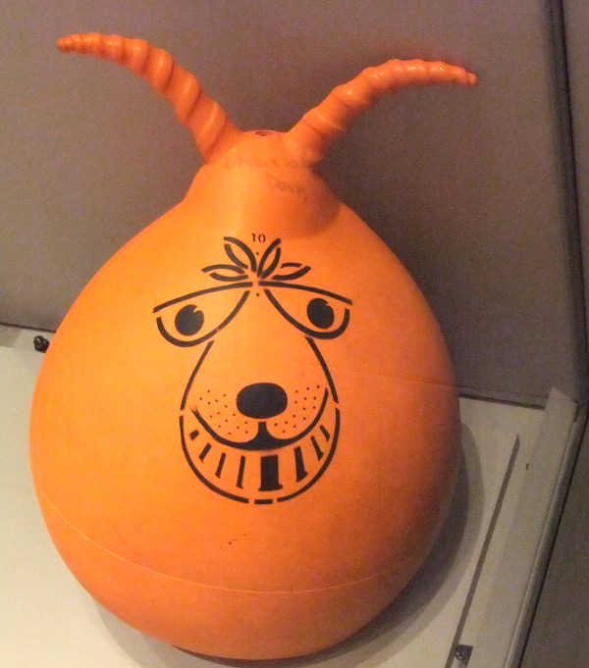
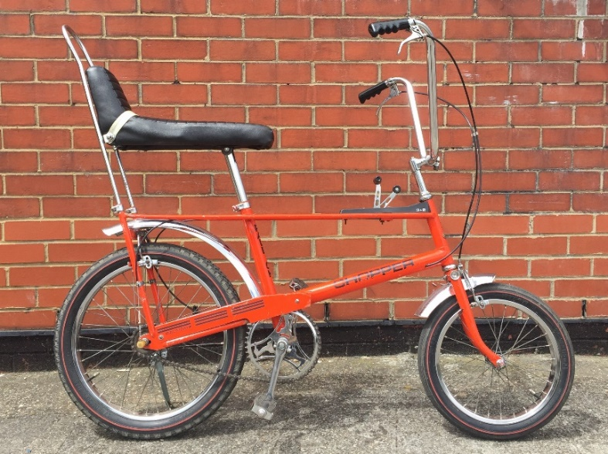
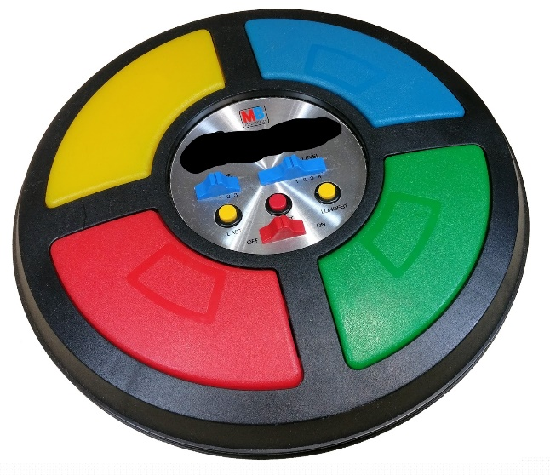
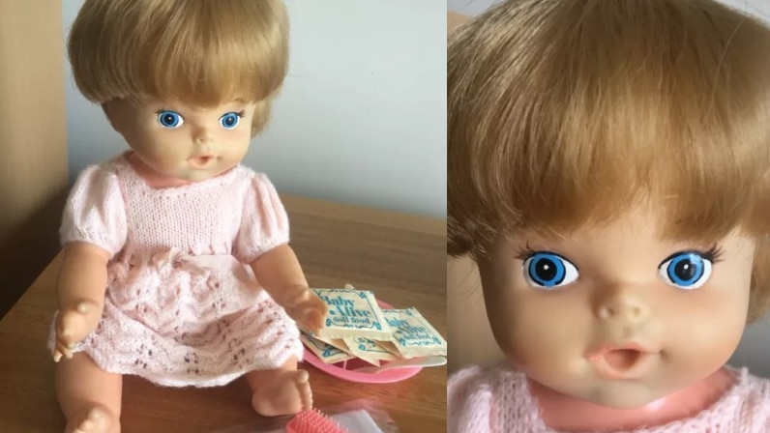
1.
2.
3.
4.
5.

Slide 34
Round 6:
Name that 70s Fashion!
5 Questions

Slide 35
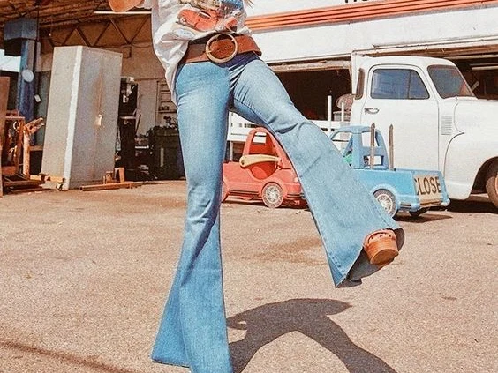
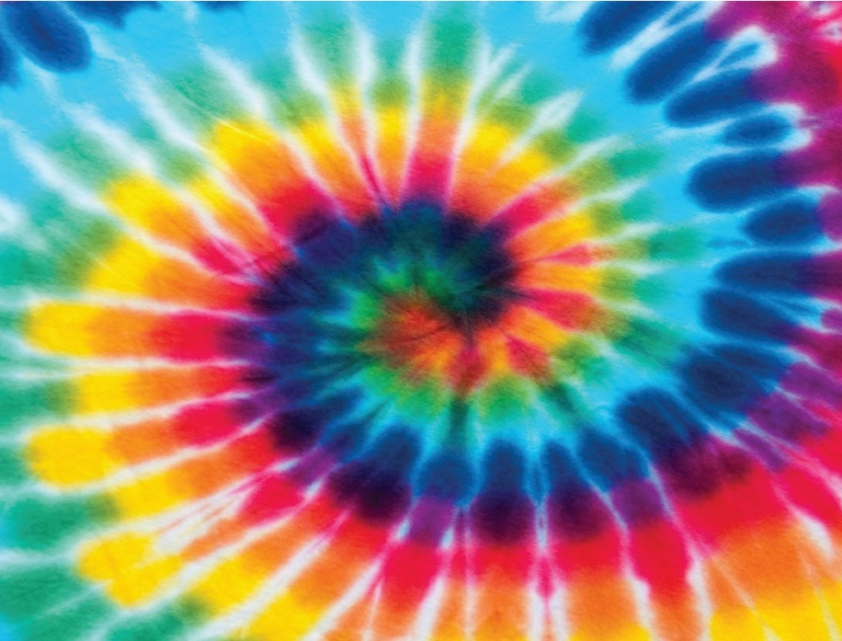
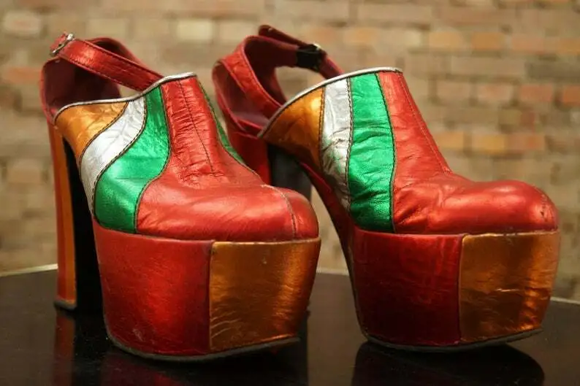
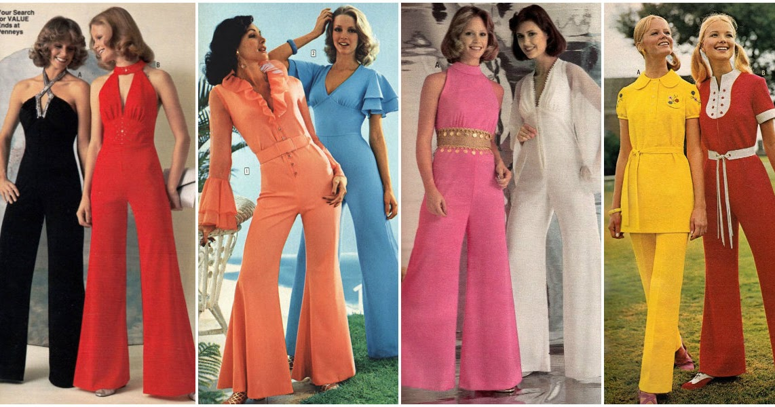

1.
2.
3.
4.
5.

Slide 36
Time for Answers!

Slide 37

Round 1 – General Knowledge
4 (Bonus points: Margaret Thatcher, James Callaghan, Harold Wilson, Edward Heath) (5 pts)
Ford Cortina (1pt)
1974 (1pt)
Glastonbury (1pt)
1979 (1pt)
Montreal, Canada (2pts)
Apollo 13 (1pt)
We went from shillings to pounds, and went decimal (1pt)
Concorde (1pt)
The Watergate Scandal (1pt)
15 points total available!

Slide 38
Round 2 – 70s Music
The Beatles (1pt)
Mull of Kintyre by Wings (2pts)
Thin Lizzy (1pt)
Simon and Garfunkel (1pt)
You’re the one that I want (1pt)
6 points total available!

Slide 39
Round 3 – TV and Film
Jaws (1pt)
A. Holmfirth (1pt)
Barker and Corbett (2pts)
1977 (1pt)
Clangers (1pt)
6 points total available!

Slide 40
Round 4 – 1970s Food
McDonald’s (1pt)
Caesar Salad (1pt)
Trifle (1pt)
Skittles (1pt)
Pringles (1pt)
5 points total available!

Slide 41
Round 5 – Name that 70s Toy
Space Hopper
Operation!
Chopper Bike
Simon
Baby Alive
5 points total available!

Slide 42
Round 6 – Name that 70s Fashion!
Bell Bottoms / Flares (1pt)
Tie Dye (1pt)
Platforms (1pt)
Jumpsuits (1pt)
Paisley (1pt)
5 points total available!

