Slide 1
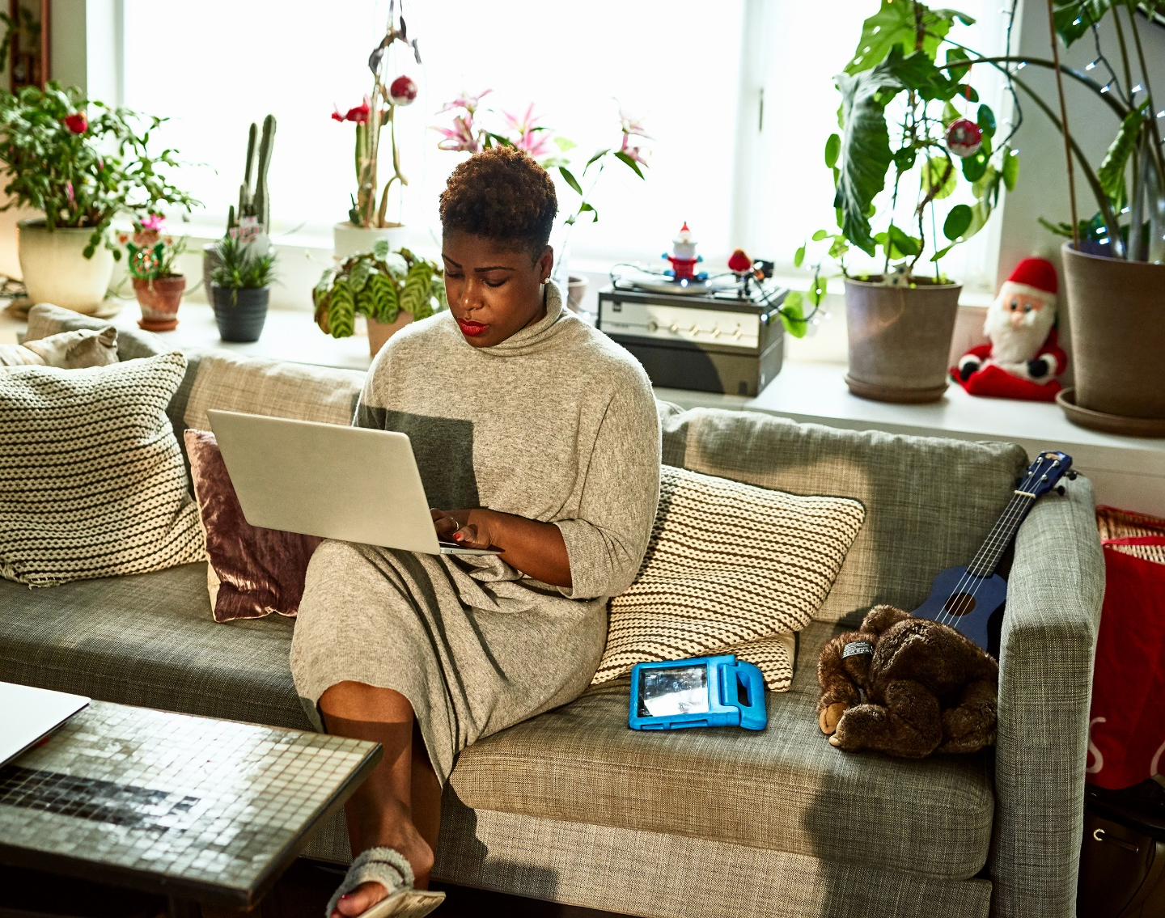
Protecting data
whilst volunteering from home

Slide 2

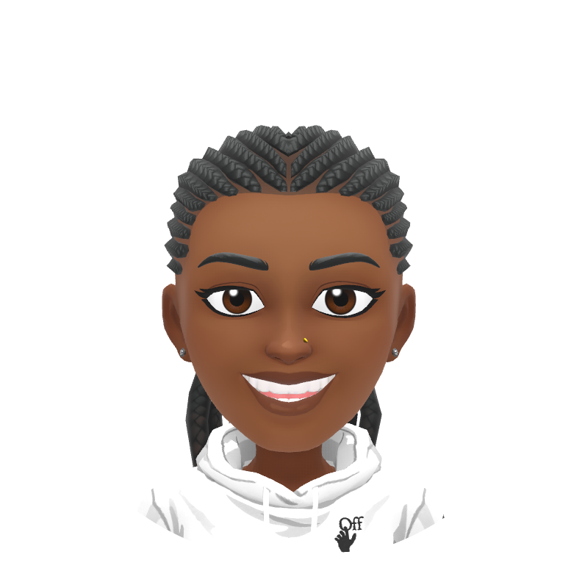
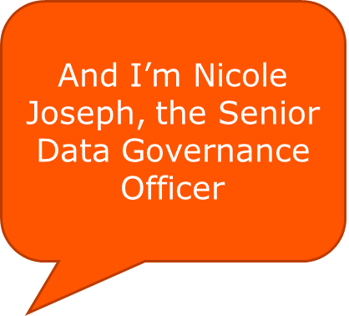
I’m Michelle Bissoo, the Data Governance Lead
We hope you enjoy this presentation and most importantly, find it useful!
We’ll share some top tips for protecting data whilst volunteering from home or on the go.
Our top 10 tips start on the next slide. Let us know what you think!

Slide 3


Don’t share your computer
Tip 1

Slide 4

Don’t share your computer
When possible, use one computer for volunteering and a different computer for everything else. Never let your kids or other family members use the computer you use for volunteering.
Personal computers can have different user logins. If you use a family computer to manage volunteering activities, use a specific login exclusively for volunteering. This ensures your MS Society volunteering files and activities remain separate from your family folders. Use the tools provided to login to your MS Society email. You can find out how to do this along with other useful information here.

Slide 5
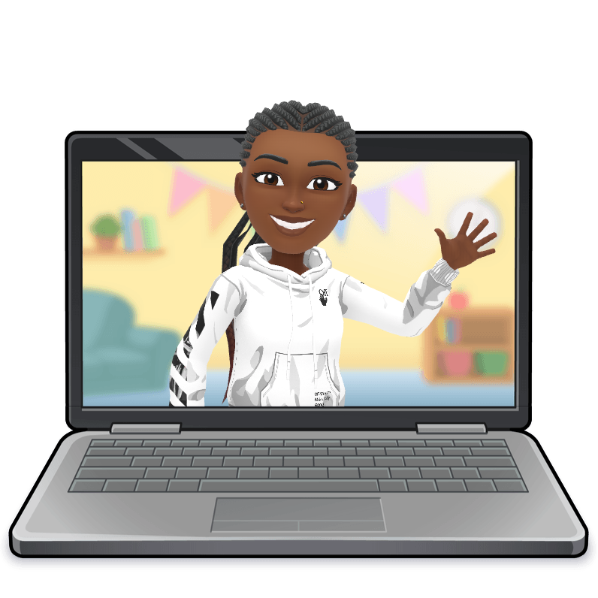

Keep it digital
Tip 2

Slide 6



Keep it digital
Avoid printing confidential information onto paper. If you must, make sure you don’t leave these documents laying out.
When you're done with these documents, shred immediately. Never place them in the rubbish or your household recycling.
2

Slide 7

Verify all unusual phone calls
Tip 3

Slide 8

Verify unusual phone calls
Cybercriminals will often call employees or volunteers pretending to work in the IT department.
If you receive an unexpected call, never give out your password or any private or confidential information.
If you're unsure, stop and call your staff contact or the Volunteer Support Team.
3

Slide 9

Update your computer
Tip 4

Slide 10

Update your computer
Make sure your computer is up to date with the latest patches and upgrades when prompted by your system.
When in doubt contact your IT/antivirus provider for help.
Computers that don’t have the latest updates are easy targets for cybercriminals.
4

Slide 11

Beware of phishing scams
Tip 5

Slide 12

Beware of phishing scams
When you receive an email, even if it comes from a fellow volunteer, MS Society employee or friend, avoid clicking on a link or opening an attachment unless you have verbal confirmation from the sender on what it is.
5

Slide 13
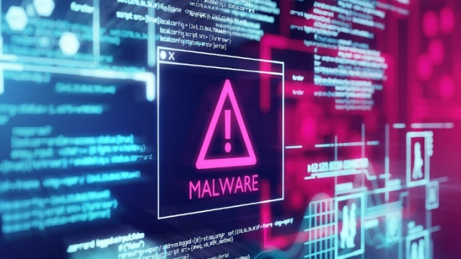
Beware of phishing scams
Remember, email is the most common way to spread malware. Once malware is on your computer, anything you can access, the criminal can access. This includes websites, email and even the organisational network.
5

Slide 14

Beware of malicious text messages
Tip 6

Slide 15


Beware of malicious text messages
A mobile device can be just as vulnerable as a desktop computer.
Beware of malicious apps and never click on links received in unsolicited texts.
6

Slide 16

Be cautious with Wi-Fi
Tip 7

Slide 17

Be cautious with Wi-Fi
Never use unsecured public Wi-Fi for volunteering purposes. The problem with unsecured public Wi-Fi is that you have no way of knowing who controls the access point. This means that a criminal could be monitoring everything you’re doing while connected in public places.
7

Slide 18
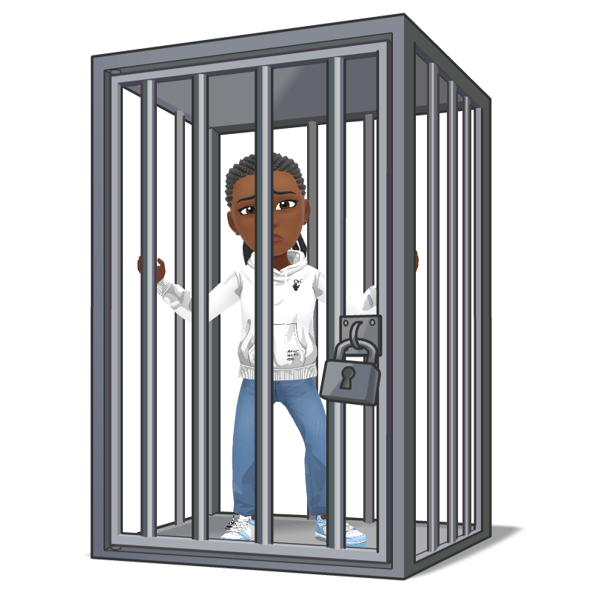

Secure your home Wi-Fi
Tip 8

Slide 19

Secure your home Wi-Fi
Make sure your home
Wi-Fi has a strong password. A simple password or no password at all will allow criminals on your network, where they can attack your computer.
8

Slide 20

Change that password
Tip 9

Slide 21
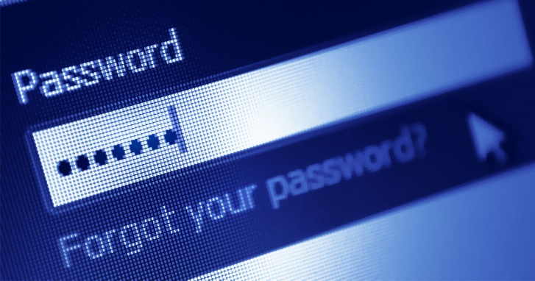
Change that password
Never use the same password more than once. If a website is hacked and a criminal gains access to your password, they will try to use that same password at other sites.
Use a password manager or other system for maintaining unique passwords for every account.
9

Slide 22

Lock your computer
Tip 10

Slide 23
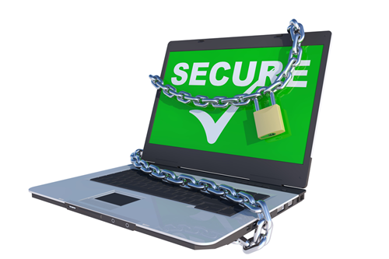
Lock your computer
(don’t wait for it to, or assume it will, fall asleep)
When you walk away from your computer, at home or on the go, lock it. It takes one extra second, and it will ensure that you and only you have access to it.
9

Slide 24
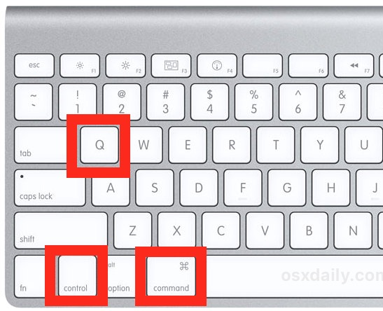

Lock your computer
To lock Windows press
“windows key” + L
To lock Macs press
“Control” + “Command” + Q
10

Slide 25

The top 10 tips
Review

Slide 26

The top 10 tips
1. Don’t share your computer
2. Keep it digital
3. Verify unusual phone calls
5. Beware of Phishing scams
4. Update your computer
6. Beware of malicious text messages
7. Be cautious with Wi-Fi
8. Secure your home Wi-Fi
9. Change that password
10. Lock your computer

Slide 27

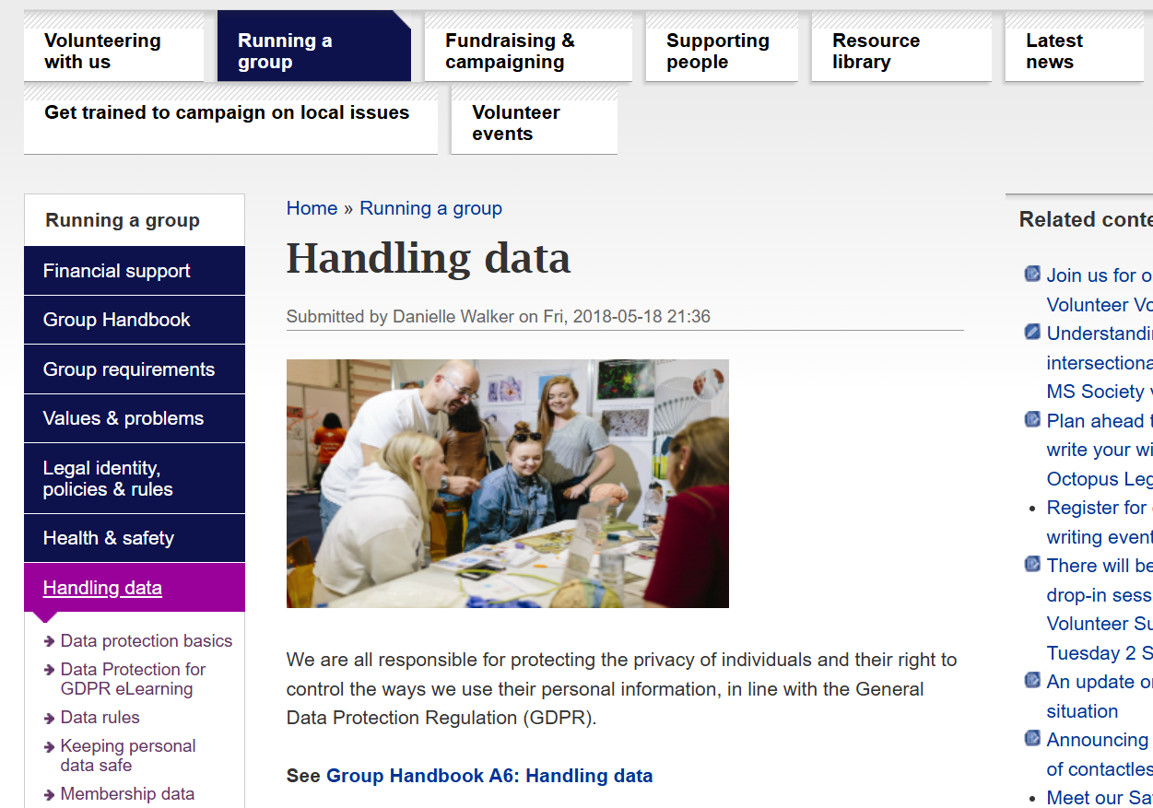


Additional sources of information
You can find lots of information on the Volunteer Website’s ‘handling data’ section.

Slide 28


If you can’t find answers in the ‘handling data’ pages, please contact the Data Governance Team via your Volunteer Support staff contact or directly at datagovernance@mssociety.org.uk.
Should the worse happen, report it immediately to dataincident@mssociety.org.uk. Copy in volunteersupport@mssociety.co.uk.

Slide 29


Stay safe now!

